Slide 1





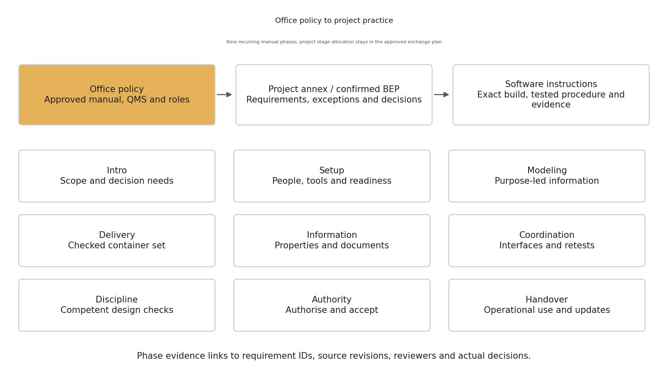
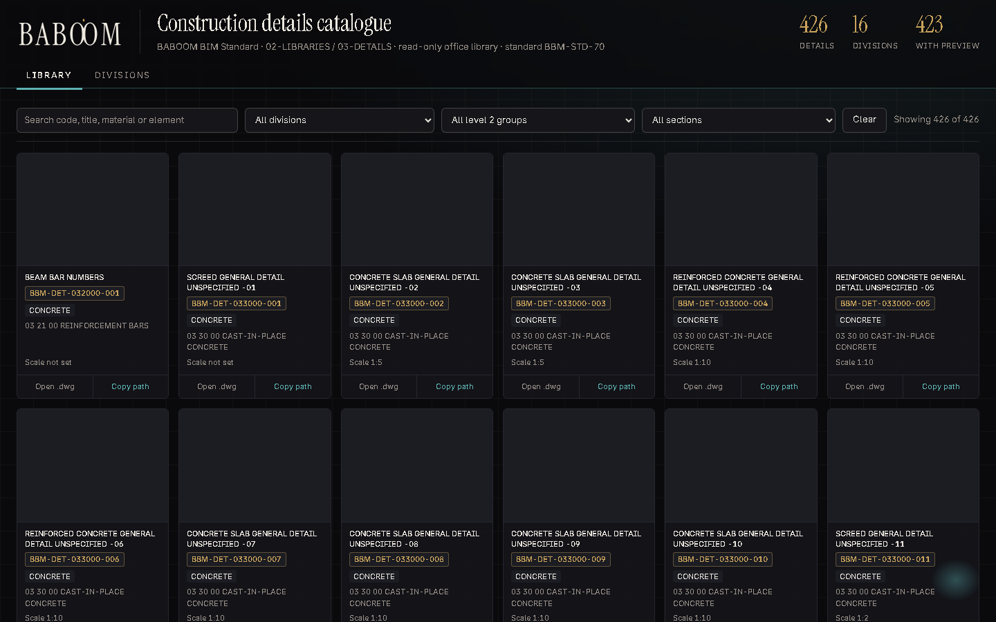
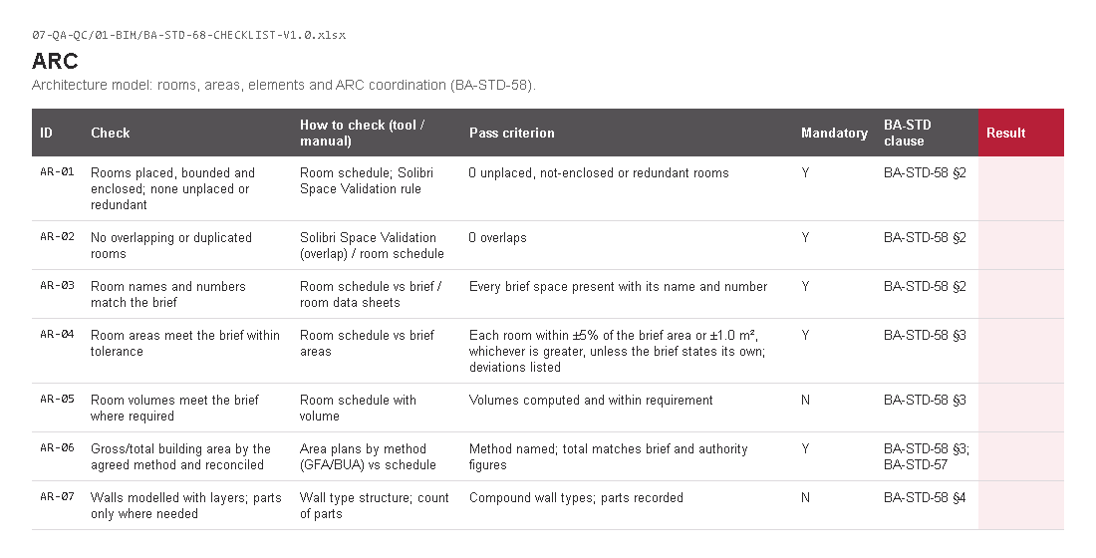
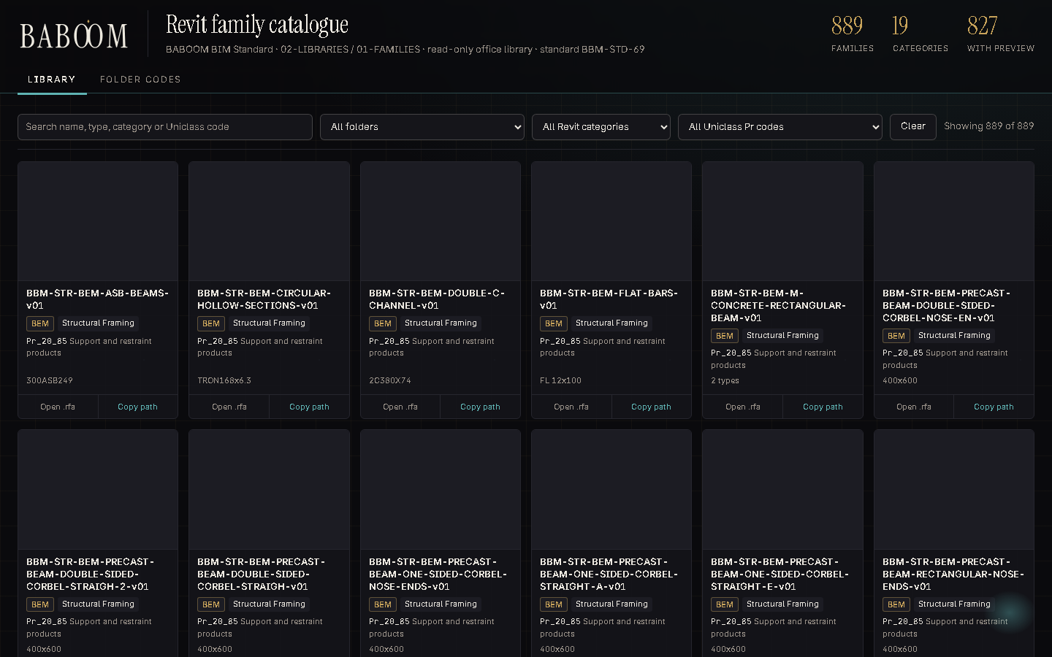
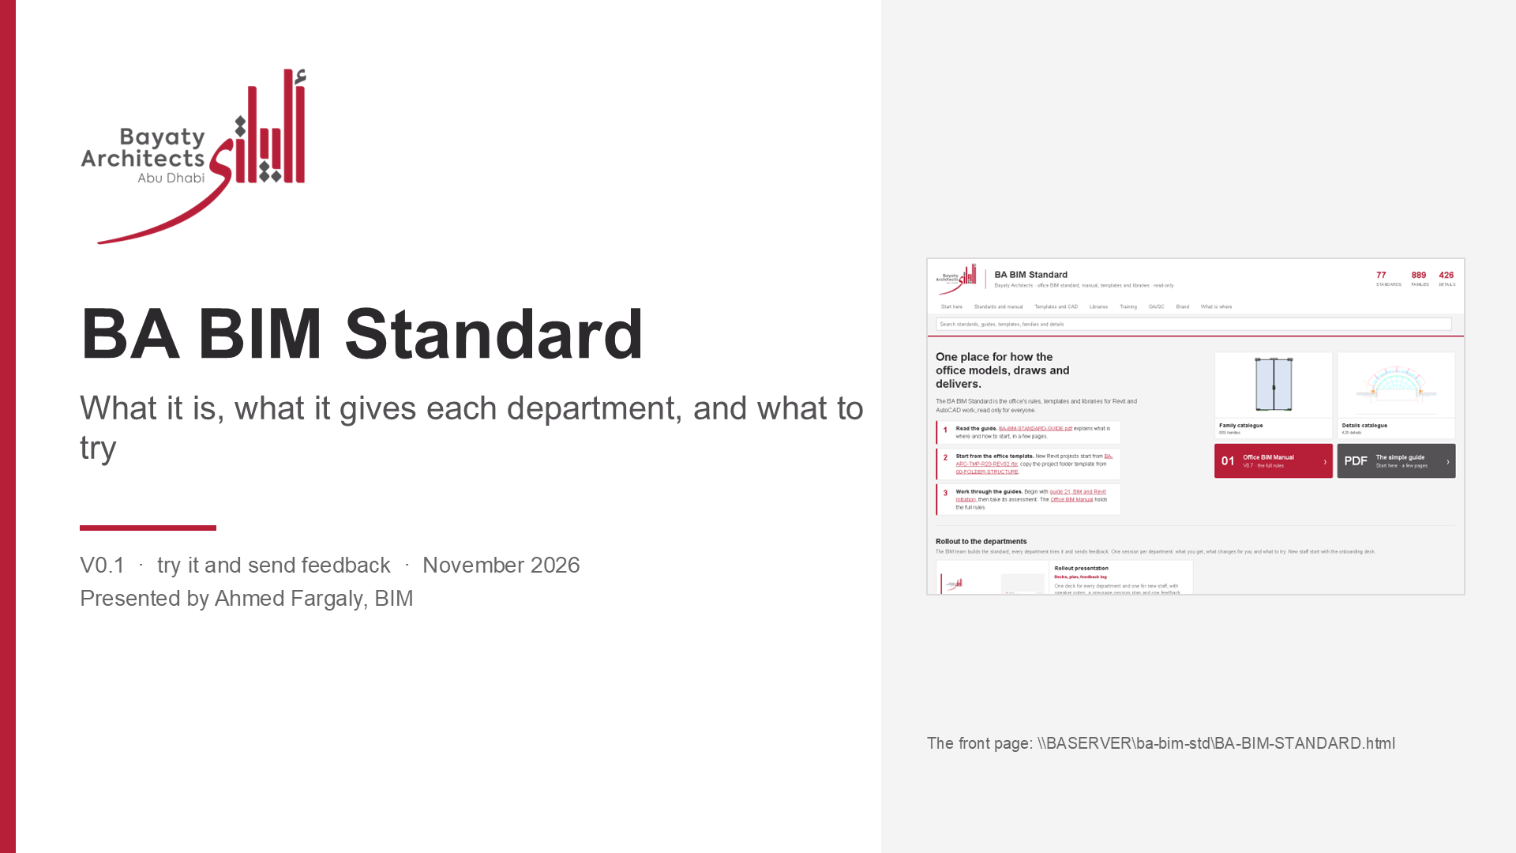
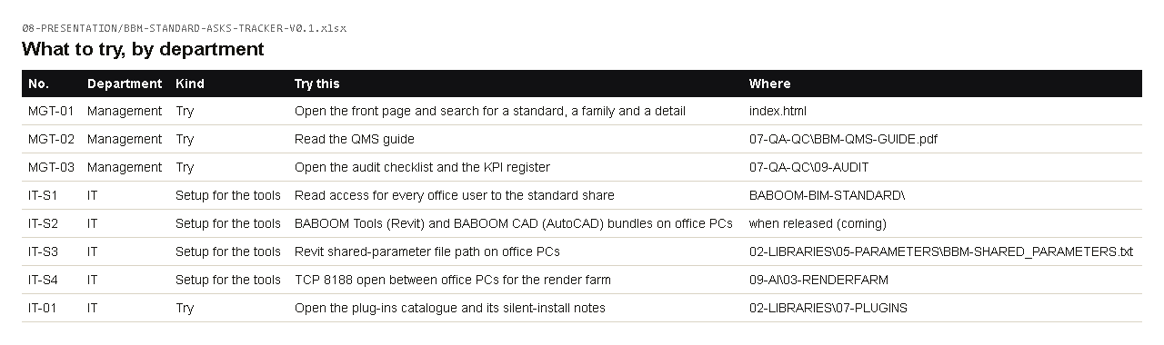
AI USE
How I use AI at work
Renders
Meeting notes
Project emails
Research
Arabic / English
Reports
Revit on projects
CAD details
Checklists
Family library
Excel trackers
Presentations
Real office work, real results. AI drafts, reads, counts and repeats; I check and sign.
BABOOM BIM Standard · rollout V0.1 · try it, send feedback · Management: AI use
1
Notes:
The things I use AI for in my office work, each with a real example in the AI use guide in 09-AI.

Slide 2


AI USE
Towers built with AI: Project and Project
Project: whole tower model built with AI
slabs, envelope, 38 cornice rings, survey position, 129 context buildings
Project: model matched to the DD drawings
plans, roof, landscape, 4 elevations placed; mirrored elevation fixed
BABOOM BIM Standard · rollout V0.1 · try it, send feedback · Management: AI use
2
Notes:
Two live towers: the Project Revit model built from our CAD with AI through ArchHub, and the Project Rhino model matched to the DD AutoCAD set.

Slide 3

AI USE
Renders: our model render, finished with AI
Before: the D5 render of our model
After: same geometry, photoreal (Nano Banana Pro)
BABOOM BIM Standard · rollout V0.1 · try it, send feedback · Management: AI use
3
Notes:
Project tower project. The render goes in as the base image so the building stays exactly as modelled.

Slide 4
AI USE
Meetings and project emails
Notion AI meeting notes
Tower B coordination: 27 action items by discipline
Emails in my Outlook house format
AI drafts, I read and send. Other names blurred.
BABOOM BIM Standard · rollout V0.1 · try it, send feedback · Management: AI use
4
Notes:
Every coordination meeting is transcribed and summarised in Notion; project emails are drafted in my format and sent by me.

Slide 5
AI USE
Revit and CAD on our projects
Tower B facade
19 sheets, 31/31 views, 670/670 grid lines
CAD details
426 details filed
Model checklists
540 checks in 9 checklists
BABOOM BIM Standard · rollout V0.1 · try it, send feedback · Management: AI use
5
Notes:
Revit and CAD work on live projects through ArchHub: placed and accepted sheets, delta updates, curtain-wall sync, details and checklists.

Slide 6
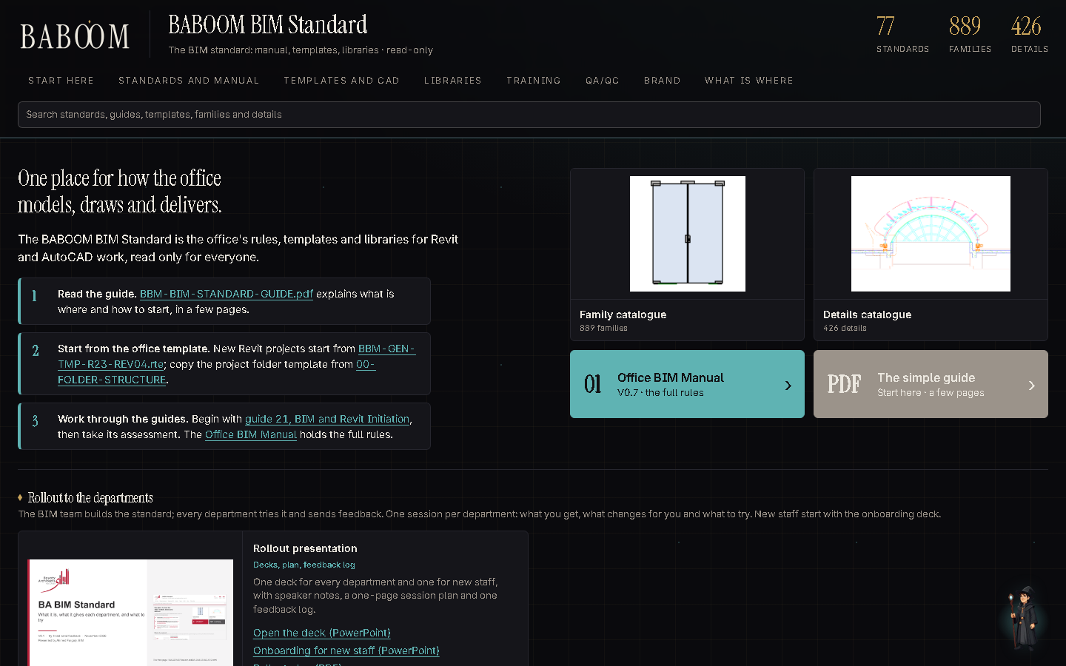
AI USE
Research, reports, libraries
Research
293 gaps found and fixed in our standard
Our standard
58 documents rebuilt, one front page
Family library
889 families with pictures
BABOOM BIM Standard · rollout V0.1 · try it, send feedback · Management: AI use
6
Notes:
Standards research from primary sources, the standard rebuilt and published on the server, and the family library catalogued.

Slide 7
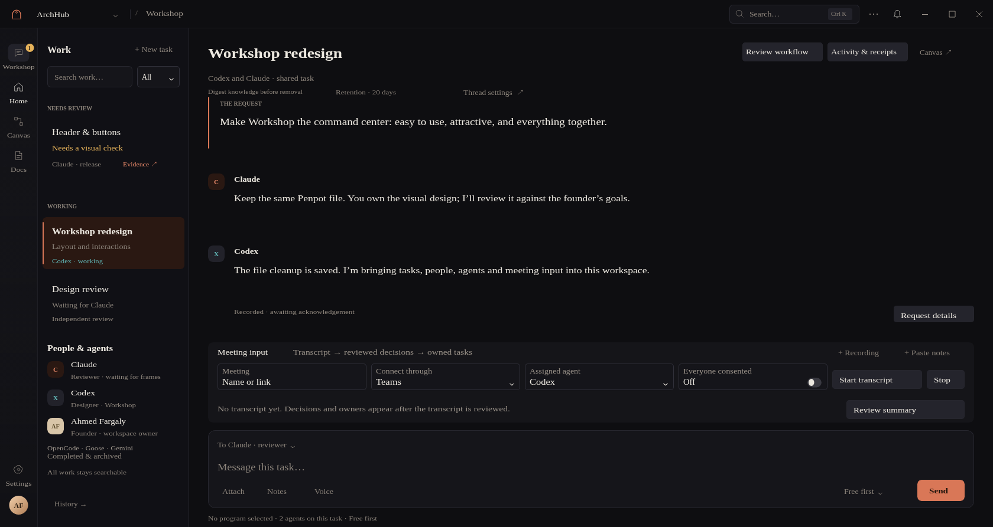
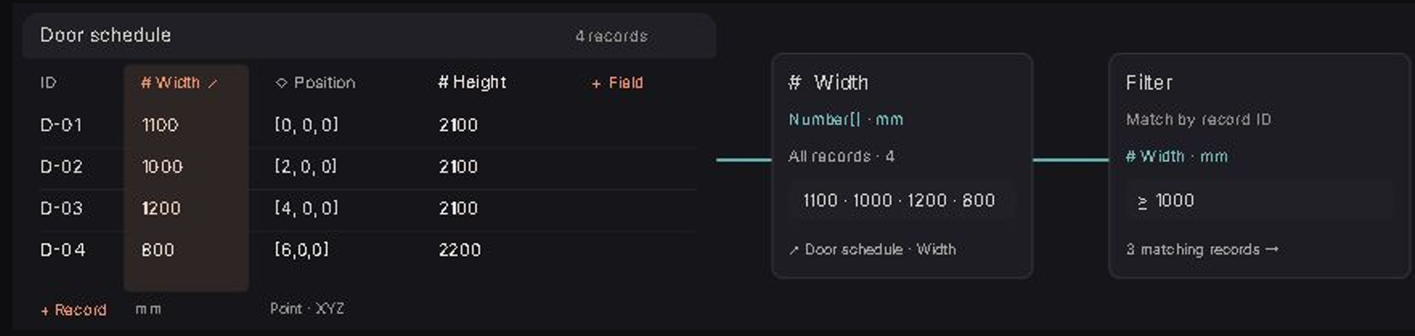
AI USE
ArchHub: one place for the AI and our programs
Connects the AI agents to Revit, AutoCAD, Excel, Word, Outlook and Notion.
Agents work together in one room, the Workshop, with us.
Nothing changes our files until we approve it.
Already used for: the project emails and the Tower B Revit work.
BABOOM BIM Standard · rollout V0.1 · try it, send feedback · Management: AI use
7
Notes:
ArchHub is the app I am building: one place where the AI agents work in our programs, together and with us. Workflows are blocks on a canvas, saved as files.

Slide 8
AI USE
What AI can do next in our work
Trackers that fill themselves
built on: from Outlook and Revit sheet lists
Meetings to owned actions
built on: from Notion AI notes
Specs from our master spec
built on: 828 master spec files on the server
Authority and code checks
built on: codes library, DoT ramp rule
CAD and Revit layer fixing
built on: from the two-tower study
Render options from the model
built on: render farm, before/after method
Batch model checks
built on: the 540 checks
Answering client comment sheets
built on: our comment trackers
Standard watch
built on: the gap audit method, run again
BABOOM BIM Standard · rollout V0.1 · try it, send feedback · Management: AI use
8
Notes:
Next uses, each built on something we already have. AI prepares, counts and drafts; the engineer checks and signs.

