Slide 1

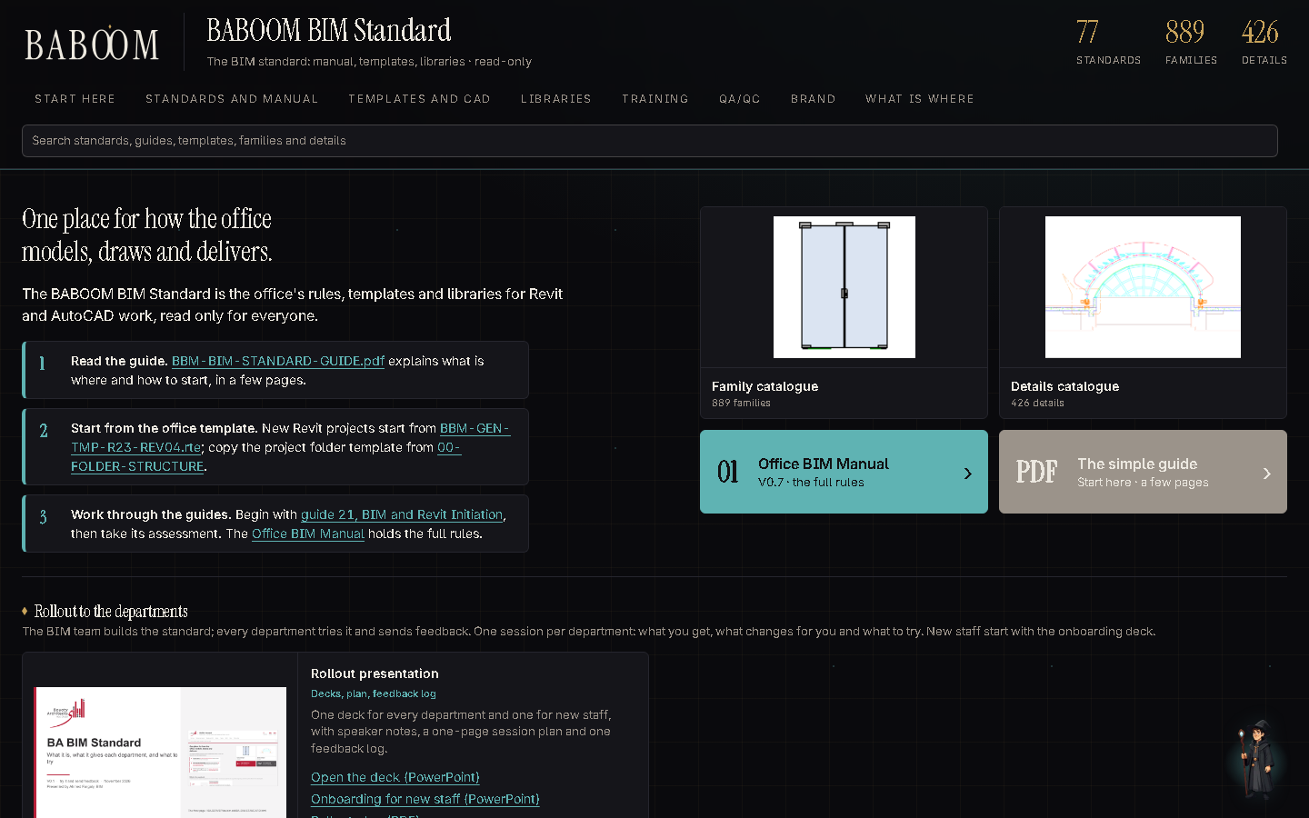
Welcome to the office
How we model, draw and deliver: the BABOOM BIM Standard in your first week
Onboarding · V0.1 · November 2026
Notes:
Welcome to the office. This short deck shows where everything is, how to set up your PC on the first day, what to read first, how we check our work, and how to send feedback. Everything it shows is on the server today.

Slide 2
1 WHERE EVERYTHING IS
One front page for everything
BABOOM-BIM-STANDARD\index.html
Double-click the page; bookmark it on day one.
One search box finds standards, families and details.
Read only: work from it, never inside it.
The simple guide: BBM-BIM-STANDARD-GUIDE.pdf.
BABOOM BIM Standard · onboarding V0.1 · Onboarding
2
Notes:
Everything lives on the BIM standard share. Open index.html and bookmark it. It links every standard, template, library, training session and checklist. The folder is read only: copy what you need into your project, never work inside it.

Slide 3
1 WHERE EVERYTHING IS
What is where
00-FOLDER-STRUCTURE
06-ASSESSMENTS
The project folder template of Manual 12.1 (00-PIM with 01-WIP, 02-SHARED, 03-PUBLISHED, …
One assessment per guide.
01-TEMPLATES
07-QA-QC
The office Revit template plus the structural and MEP discipline templates (under audit), …
Quality management: the QMS guide and one checklist workbook per area, 01-BIM to 09-AUDIT.
02-LIBRARIES
08-PRESENTATION
Families, details, materials, references and codes, parameters, scripts, plug-ins, …
The rollout to every department and the onboarding deck for new staff: decks, one-page …
03-TRAINING
09-AI
Workshop recordings and the training agenda.
AI models used by the office tools.
04-DOCUMENTS
98-ARCHIVE
The standards: Glossary, Manual, BEP, requirements, registers and discipline standards.
Superseded and retired files. Read only; never work from here.
05-METHODOLOGIES-AND-GUIDELINES
Guides 21 to 37: step-by-step Revit methods.
BABOOM BIM Standard · onboarding V0.1 · Onboarding
3
Notes:
These are the folders of the share. You will use 01-TEMPLATES, 02-LIBRARIES and 07-QA-QC every week, and the guides in 05 with their assessments in 06 during your first month. Never work from 98-ARCHIVE.

Slide 4
2 FIRST DAY SET-UP
Set up your PC on day one
1
Template
Every discipline starts new Revit projects from BBM-GEN-TMP-R23-REV04.rte.
01-TEMPLATES\02-REVIT
2
Shared parameters
Point Revit to the office file: Manage > Shared Parameters, or SharedParametersFilename in Revit.ini.
02-LIBRARIES\05-PARAMETERS\BBM-SHARED_PARAMETERS.txt
3
Folder tree
Every project copies the office folder tree.
00-FOLDER-STRUCTURE
4
Catalogues
Bookmark the family catalogue (889) and the details catalogue (426).
02-LIBRARIES\01-FAMILIES, 03-DETAILS
5
Email signature
Install the office signature with your name and title.
01-TEMPLATES\03-BRANDING\03-SIGNATURES
BABOOM BIM Standard · onboarding V0.1 · Onboarding
4
Notes:
Your first-day set-up. One: start every Revit project from the office template. Two: point Revit to the office shared parameter file, either in Manage, Shared Parameters, or with the SharedParametersFilename line in Revit.ini. Three: copy the project folder tree. Four: bookmark the two catalogues. Five: install the office email signature.

Slide 5
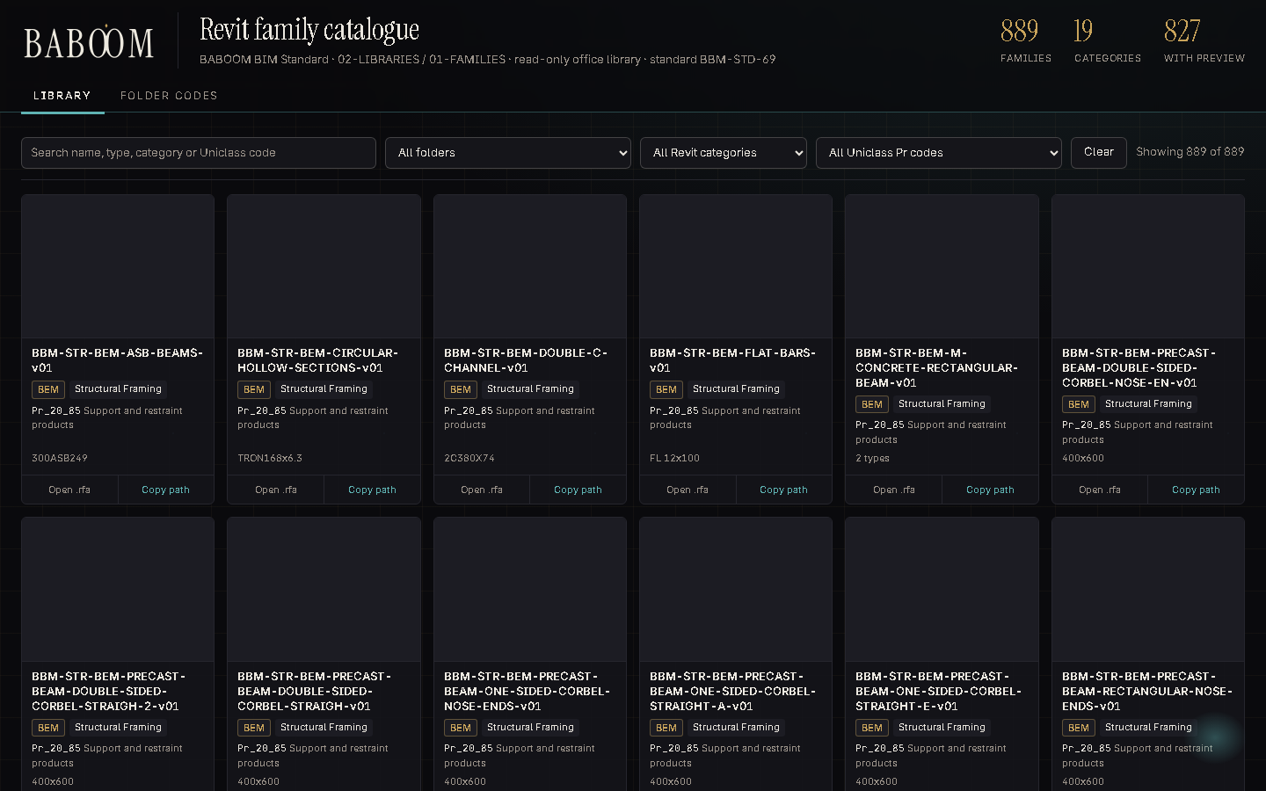
3 LIBRARIES
Families: search, preview, load
The family catalogue (02-LIBRARIES\01-FAMILIES\CATALOGUE.html)
BABOOM BIM Standard · onboarding V0.1 · Onboarding
5
Notes:
The family catalogue shows every office family with a preview. Search by name or category, then load it into your model. Do not download families from the internet into projects.

Slide 6
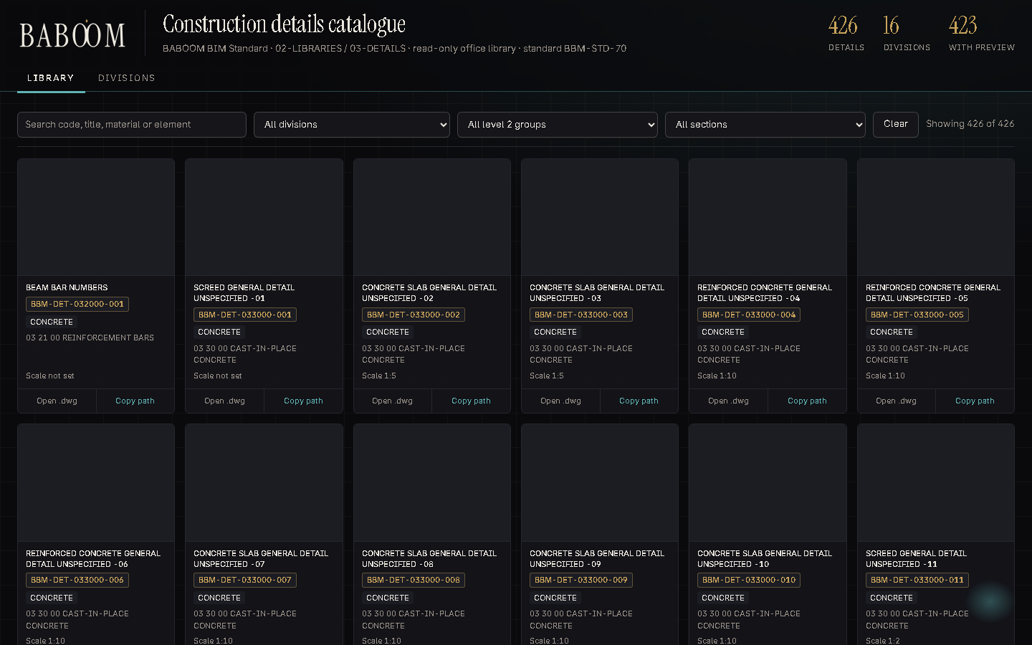
3 LIBRARIES
Details: filed by MasterFormat
The details catalogue (02-LIBRARIES\03-DETAILS\CATALOGUE.html)
BABOOM BIM Standard · onboarding V0.1 · Onboarding
6
Notes:
The details catalogue holds the office construction details, filed by CSI MasterFormat division, with a preview of each one.

Slide 7
4 WHAT TO READ, IN ORDER
The guides, in order, each with an assessment
21
BIM and Revit Initiation
30
Setting Up a Building File: URS, Levels, Links and Plug-ins
22
Work Sharing and Collaboration
31
Enhanced Workflow: Daily Progress, Clean Data and Productivity Plug-ins
23
Bringing in CAD Cleanly and Complex Walls
32
Rooms, Areas and Model Quality Control
24
Curtain Walls and Curtain Systems
33
Finishes with Plug-ins, Phases and Getting Ready for Design
25
Project Initiation: Worked Example
34
Railings, Stairs and Ramps
26
Introduction to Families and Parameters
35
Importing Families from Outside
27
Families and Parameters in Practice
36
Data Control with Schedules
28
Documentation: Overrides, View Templates and Filters
37
Building a Family: Worked Example: a Chair
29
Complex Geometry: Pattern-Based and Adaptive Families and Quick Renders
Guides: 05-METHODOLOGIES-AND-GUIDELINES. Assessments: 06-ASSESSMENTS, marked by the BIM team. Recordings: 03-TRAINING.
BABOOM BIM Standard · onboarding V0.1 · Onboarding
7
Notes:
Read the 17 guides in this order, starting with guide 21. After each guide, take its assessment; the BIM team marks it. Each guide also has a recorded workshop in 03-TRAINING.

Slide 8
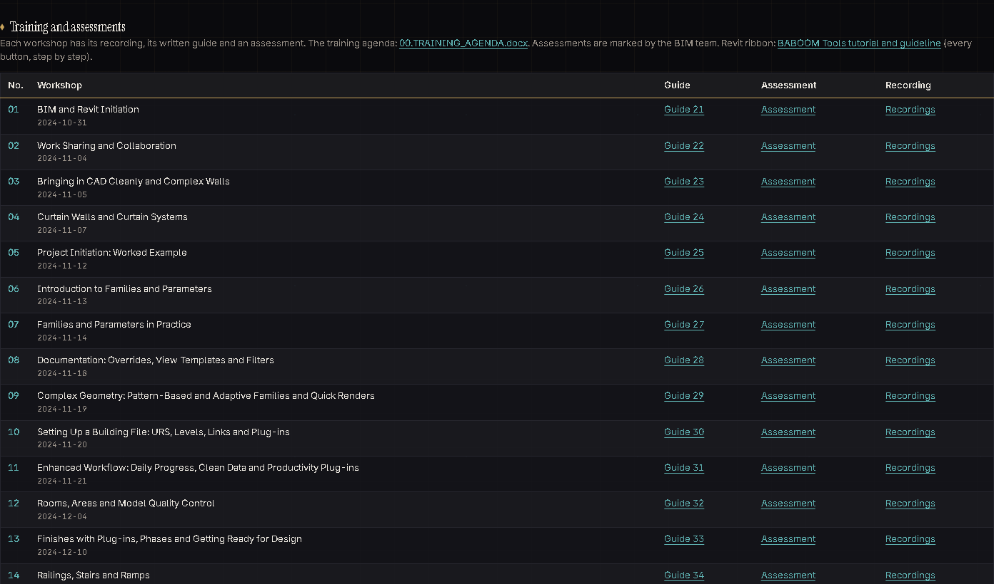
4 WHAT TO READ, IN ORDER
Training on the front page
The training table on the front page: workshop, guide, assessment and recording in one row
BABOOM BIM Standard · onboarding V0.1 · Onboarding
8
Notes:
The same list on the front page: each row has the workshop, its written guide, its assessment and the recording.

Slide 9
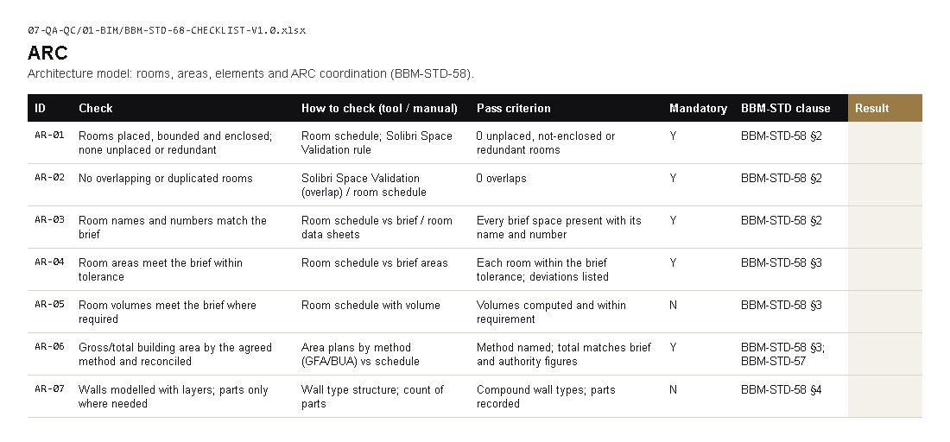
5 HOW WE CHECK OUR WORK
A checklist for every issue
01 BIM model
02 Design review
03 Proposals
04 Specifications
05 Sustainability
06 Authority submissions
07 Site supervision
08 Document control
09 Quality audit
Copy the workbook into the project QA folder before use.
BIM checklist, sheet ARC (07-QA-QC\01-BIM)
BABOOM BIM Standard · onboarding V0.1 · Onboarding
9
Notes:
Before anything leaves the office, the checklist for that area is filled and signed. Copy the workbook into the project QA folder, fill the Result column, write notes in the Comment column, and sign it.

Slide 10
6 THE BABOOM RIBBON
Coming: the BABOOM ribbon in Revit
COMING: designed, not built yet
BABOOM Tools: our own Revit add-in (2023–2027) + BABOOM CAD for AutoCAD, office-only, not pyRevit
BABOOM Tools tab: 72 buttons for everyone; BABOOM Engineering tab: 70 buttons by discipline
BABOOM BIM Standard · onboarding V0.1 · Onboarding
10
Notes:
The BABOOM ribbon is coming to Revit: our own add-in for Revit 2023 to 2027, plus BABOOM CAD for AutoCAD. Each button runs one rule of the standard, such as starting a project from the template or checking names. When it reaches your PC, use it and send feedback.

Slide 11
7 FEEDBACK
Something missing or wrong? Tell us
Write it
Or comment
We answer
In the feedback log: 08-PRESENTATION\BBM-STANDARD-ASKS-TRACKER-V0.1.xlsx, sheet Feedback.
In the Comment column of the checklist you used.
The BIM team answers every comment and fixes it in the next version.
BABOOM BIM Standard · onboarding V0.1 · Onboarding
11
Notes:
If something is missing, wrong or hard to use, write it in the feedback log, or in the Comment column of the checklist. The BIM team answers every comment and fixes it in the next version.

Slide 12

Welcome aboard
Start here: BABOOM-BIM-STANDARD\index.html
Then: guide 21, its assessment, and your first project from the template
Notes:
Welcome aboard. Start at the front page, read guide 21 and take its assessment, and start your first project from the office template.

