Slide 1


BABOOM BIM Standard
What it is, what it gives each department, and what to try
V0.1 · try it and send feedback · November 2026
Presented by Ahmed Fargaly, BIM
The front page: BABOOM-BIM-STANDARD\index.html
Notes:
Welcome, and thank you for the time. The standard is on the server today and the BIM team keeps building it. In the next minutes I will show what the standard is, where it lives, and how it works day to day. Then I will show what it gives your department, what changes for you, and what to try. Your feedback is what makes the next version better.

Slide 2
Common core
Today
1
Why one standard
Try it, send feedback
The standard is on the server and you can use it today.
The BIM team builds it and keeps it up to date.
Your feedback goes in one log; every comment gets an answer.
2
What is in it
3
Where to find it
4
How it works day to day
5
Your department: what you get, what changes, what to try
6
How to send feedback
BABOOM BIM Standard · rollout V0.1 · try it, send feedback · Common core
2
Notes:
Here is the plan for the session. Parts 1 to 4 are the same for every department and take about fifteen minutes. Part 5 is about your department only. The box on the right is the whole idea: use it, try it on real work, and write what works and what does not in the feedback log. The BIM team answers every comment.

Slide 3
Common core
Why one standard
01
02
03
One way to start
One way to name and find
One way to check before we issue
Every project starts from the same template and the same folder tree.
Files, views and sheets use one set of codes; every library has a catalogue with search.
One checklist per area, signed before anything leaves the office.
The office already has good templates, families and forms. The standard puts them in one place, under one set of rules.
BABOOM BIM Standard · rollout V0.1 · try it, send feedback · Common core
3
Notes:
Why do we need this? The office already has good material: templates, families, details and forms. The problem is that they live in many places and each project sets them up a little differently. The standard gives us three simple things: one way to start a project, one way to name and find things, and one way to check work before it leaves the office.

Slide 4
Common core
What is in it
77
889
426
557
standards and guides
Revit families
construction details
master spec sections
04-DOCUMENTS
02-LIBRARIES
02-LIBRARIES
02-LIBRARIES
9
25
17
142
QA/QC checklist workbooks
document control forms
training guides with assessments
ribbon buttons (coming)
07-QA-QC
01-TEMPLATES
05 and 06
BABOOM Tools, BABOOM Engineering
BABOOM BIM Standard · rollout V0.1 · try it, send feedback · Common core
4
Notes:
This is what is in the standard today. Every number on this slide is counted from the files on the server. 77 standards and guides, 889 Revit families, 426 details, 557 master specification sections, 9 checklist workbooks, 25 document control forms and 17 training guides, each with an assessment. The last tile, 142 ribbon buttons, is designed but not built yet; I will show it at the end of this part.

Slide 5
Common core
Where to find it
BABOOM-BIM-STANDARD\index.html
Double-click the page. One search box finds standards, families and details.
Read only for everyone. The BIM team publishes every change.
The simple guide: BBM-BIM-STANDARD-GUIDE.pdf, a few pages.
Old versions sit in each folder's 98-ARCHIVE. Never work from there.
BABOOM BIM Standard · rollout V0.1 · try it, send feedback · Common core
5
Notes:
Everything lives in one place: the BABOOM BIM Standard folder on BABOOM-BIM-STANDARD. Open the file index.html; it is the front page you see here. It links every standard, template, library, training session and checklist, and the search box finds a standard number, a family or a detail. The folder is read only; the BIM team publishes changes. If you want a short introduction, read the simple guide PDF in the same folder.

Slide 6
Common core
How it works day to day
Template
Folders
Naming
Libraries
Checks
Issue
Start from the office template
Copy the project folder tree
Name files, views, sheets
Take families and details
Fill and sign the checklist
Send with a transmittal
BBM-GEN-TMP-R23-REV04
00-FOLDER-STRUCTURE
BBM-STD-93 codes
02-LIBRARIES
07-QA-QC
BBM-STD-57
Same six steps on every project. Each step points to one place on the server and one clause of the standard, so anyone can pick up a project and find their way.
BABOOM BIM Standard · rollout V0.1 · try it, send feedback · Common core
6
Notes:
This is how the standard works on a normal day. One: start from the office template. Two: copy the project folder tree. Three: name files, views and sheets with the office codes in BBM-STD-93. Four: take families and details from the libraries. Five: before an issue, fill and sign the checklist for your area. Six: send the issue with an office transmittal. The steps are the same on every project.

Slide 7
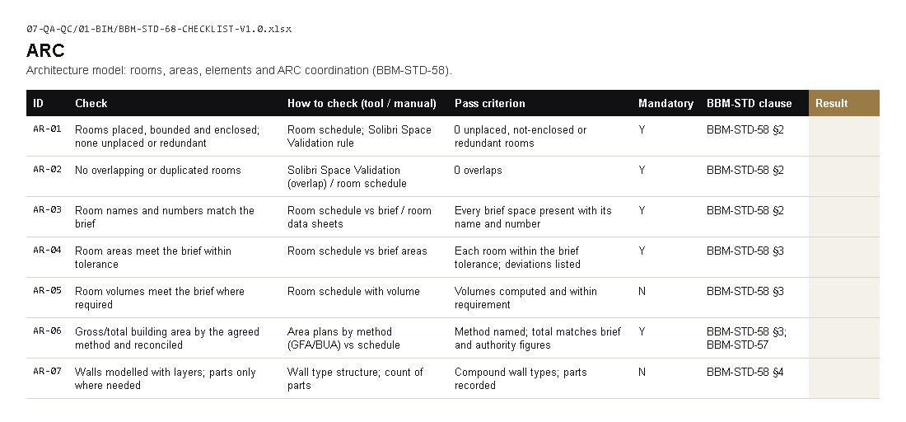
Common core
One quality system: a checklist per area
01 BIM model
02 Design review
03 Proposals
04 Specifications
05 Sustainability
06 Authority submissions
07 Site supervision
08 Document control
09 Quality audit
All in 07-QA-QC, with the QMS guide (BBM-STD-96, 97, 98).
BIM checklist, sheet ARC: each row has the check, how to check, the pass rule and the clause
BABOOM BIM Standard · rollout V0.1 · try it, send feedback · Common core
7
Notes:
Quality checks follow one system. There is one checklist workbook per area, from the BIM model to the quality audit. Each row says what to check, how to check it, what counts as a pass and which clause of the standard asks for it. You copy the workbook into the project quality folder, fill the Result column and sign it before the issue.

Slide 8
Common core
Coming: the BABOOM ribbon in Revit
COMING: designed, not built yet
142 buttons on two tabs; every button points to a clause of the standard
BABOOM Tools: 72 buttons for everyone
BABOOM Tools: our own Revit add-in (2023–2027) + BABOOM CAD for AutoCAD, office-only, not pyRevit
BABOOM Engineering: 70 buttons, by discipline
BABOOM BIM Standard · rollout V0.1 · try it, send feedback · Common core
8
Notes:
This is coming, not ready. It is the design of the BABOOM ribbon inside Revit: two tabs, BABOOM Tools for everyone and BABOOM Engineering by discipline. Each button runs one rule of the standard, such as starting a project from the template or checking names. It is designed but not built yet; when it reaches your PC, please try it and send feedback.

Slide 9
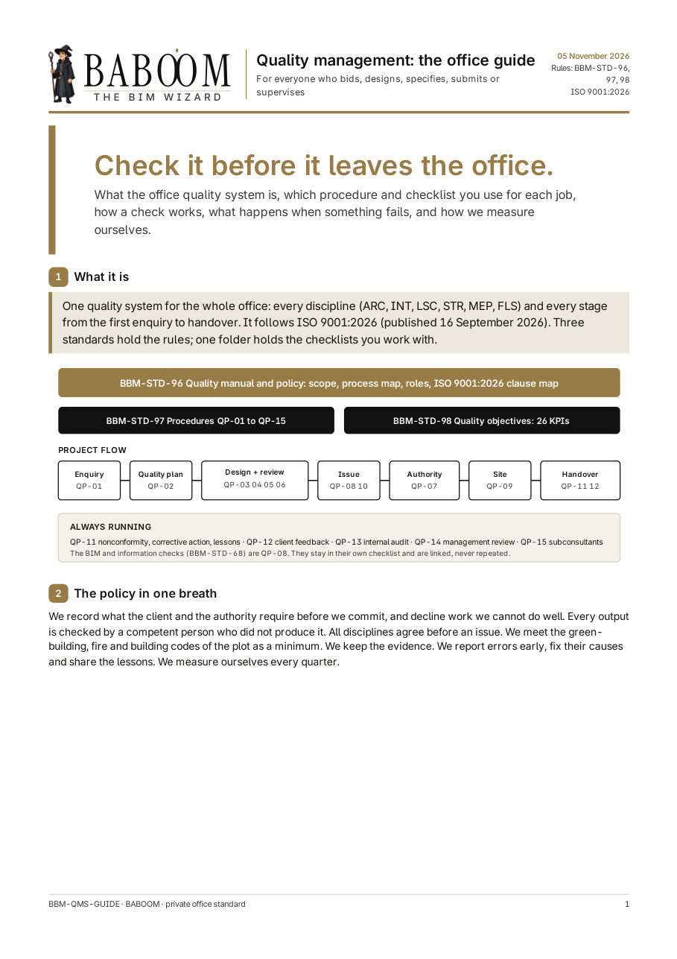
MANAGEMENT
What's in it for you
1
One office rule set
77 documents in 04-DOCUMENTS
2
Quality you can audit
BBM-STD-96 QMS, 97 procedures, 98 KPIs
3
Audit checklist and KPI register
07-QA-QC\09-AUDIT
4
Decisions on record
BBM-STD-11 Decisions log
Coming for you: a model dashboard of every project's health, and the standard watch that re-checks laws and codes.
The office quality management guide (07-QA-QC\BBM-QMS-GUIDE.pdf)
BABOOM BIM Standard · rollout V0.1 · try it, send feedback · Management
9
Notes:
A briefing, the same as every other session: what the standard is, what it gives the office, and how to send feedback. Here is what the standard gives you. 1: One office rule set, in 77 documents in 04-DOCUMENTS. 2: Quality you can audit, in BBM-STD-96 QMS, 97 procedures, 98 KPIs. 3: Audit checklist and KPI register, in 07-QA-QC\09-AUDIT. 4: Decisions on record, in BBM-STD-11 Decisions log. On the right is the real page on the server: The office quality management guide (07-QA-QC\BBM-QMS-GUIDE.pdf). If there is time, open it live from the front page. Coming for you next: a model dashboard of every project's health, and the standard watch that re-checks laws and codes.

Slide 10
MANAGEMENT
What changes for you
Office decisions are written in the decisions log (BBM-STD-11), not in emails.
The quality KPIs (BBM-STD-98) can be read at any time from the KPI register.
Every department works from the same front page and the same checklists.
The BIM team keeps the standard up to date from the feedback it receives.
BABOOM BIM Standard · rollout V0.1 · try it, send feedback · Management
10
Notes:
These are the concrete changes for your team. Office decisions are written in the decisions log (BBM-STD-11), not in emails. The quality KPIs (BBM-STD-98) can be read at any time from the KPI register. Every department works from the same front page and the same checklists. The BIM team keeps the standard up to date from the feedback it receives.

Slide 11




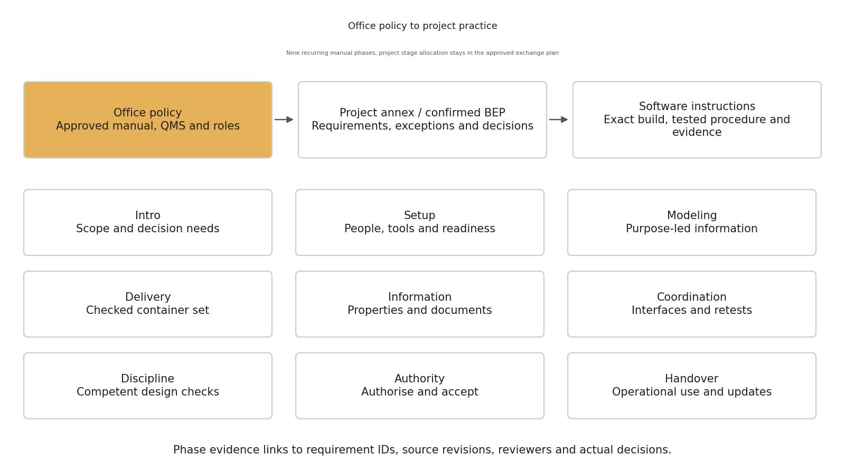
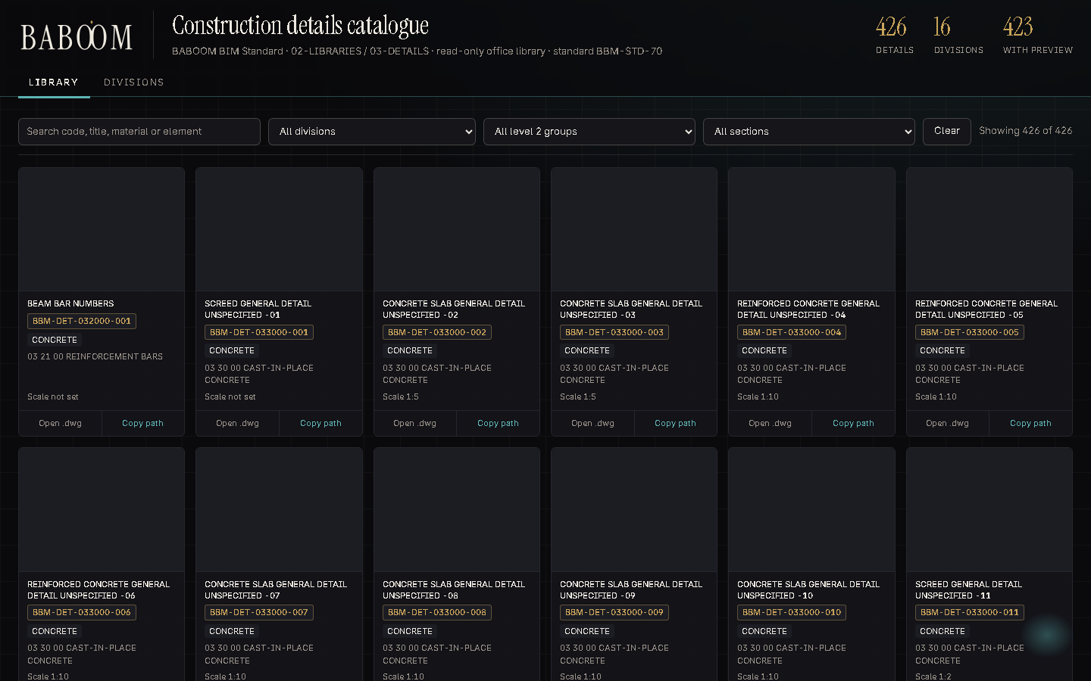
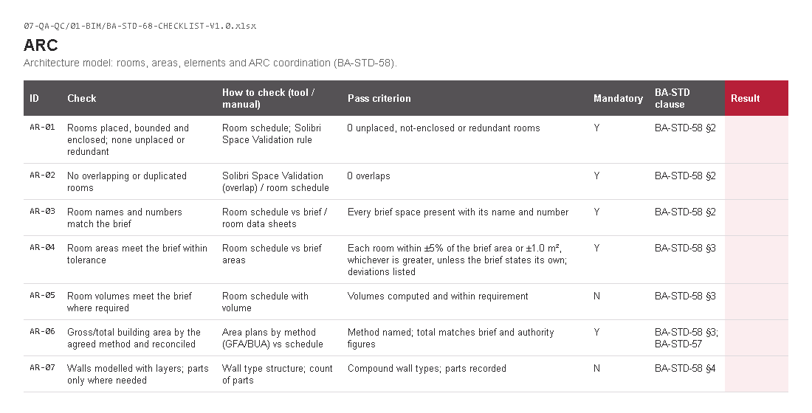
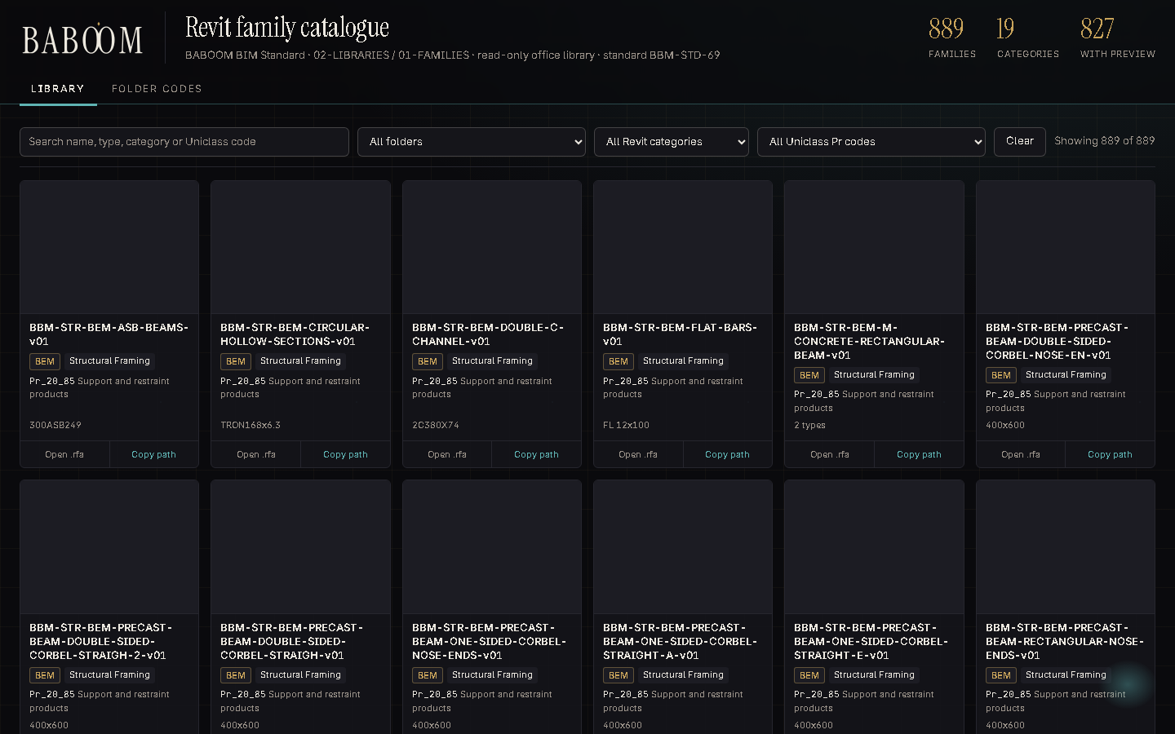
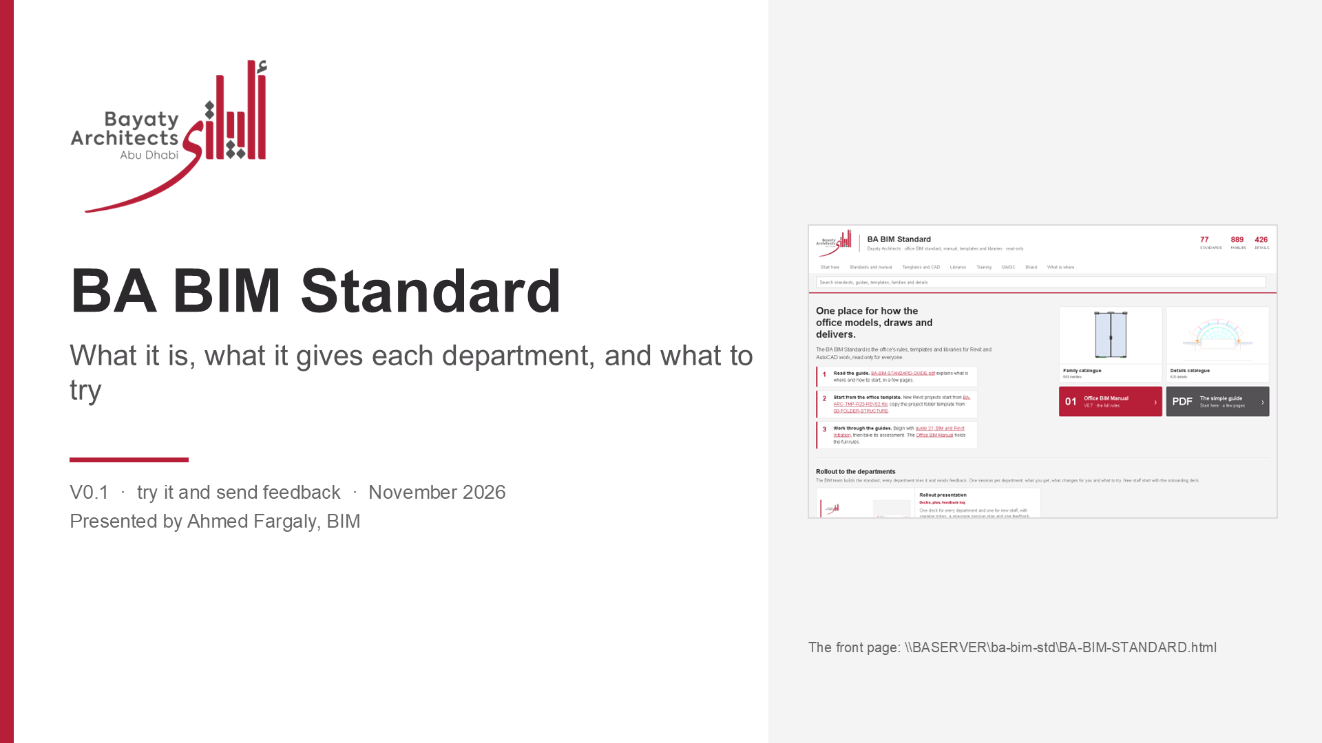
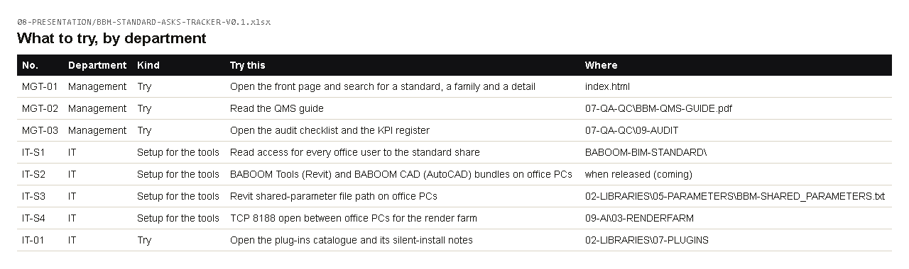
AI USE
How I use AI at work
Renders
Meeting notes
Project emails
Research
Arabic / English
Reports
Revit on projects
CAD details
Checklists
Family library
Excel trackers
Presentations
Real office work, real results. AI drafts, reads, counts and repeats; I check and sign.
BABOOM BIM Standard · rollout V0.1 · try it, send feedback · Management: AI use
11
Notes:
The things I use AI for in my office work, each with a real example in the AI use guide in 09-AI.

Slide 12


AI USE
Towers built with AI: Project and Project
Project: whole tower model built with AI
slabs, envelope, 38 cornice rings, survey position, 129 context buildings
Project: model matched to the DD drawings
plans, roof, landscape, 4 elevations placed; mirrored elevation fixed
BABOOM BIM Standard · rollout V0.1 · try it, send feedback · Management: AI use
12
Notes:
Two live towers: the Project Revit model built from our CAD with AI through ArchHub, and the Project Rhino model matched to the DD AutoCAD set.

Slide 13

AI USE
Renders: our model render, finished with AI
Before: the D5 render of our model
After: same geometry, photoreal (Nano Banana Pro)
BABOOM BIM Standard · rollout V0.1 · try it, send feedback · Management: AI use
13
Notes:
Project tower project. The render goes in as the base image so the building stays exactly as modelled.

Slide 14
AI USE
Meetings and project emails
Notion AI meeting notes
Tower B coordination: 27 action items by discipline
Emails in my Outlook house format
AI drafts, I read and send. Other names blurred.
BABOOM BIM Standard · rollout V0.1 · try it, send feedback · Management: AI use
14
Notes:
Every coordination meeting is transcribed and summarised in Notion; project emails are drafted in my format and sent by me.

Slide 15
AI USE
Revit and CAD on our projects
Tower B facade
19 sheets, 31/31 views, 670/670 grid lines
CAD details
426 details filed
Model checklists
540 checks in 9 checklists
BABOOM BIM Standard · rollout V0.1 · try it, send feedback · Management: AI use
15
Notes:
Revit and CAD work on live projects through ArchHub: placed and accepted sheets, delta updates, curtain-wall sync, details and checklists.

Slide 16
AI USE
Research, reports, libraries
Research
293 gaps found and fixed in our standard
Our standard
58 documents rebuilt, one front page
Family library
889 families with pictures
BABOOM BIM Standard · rollout V0.1 · try it, send feedback · Management: AI use
16
Notes:
Standards research from primary sources, the standard rebuilt and published on the server, and the family library catalogued.

Slide 17
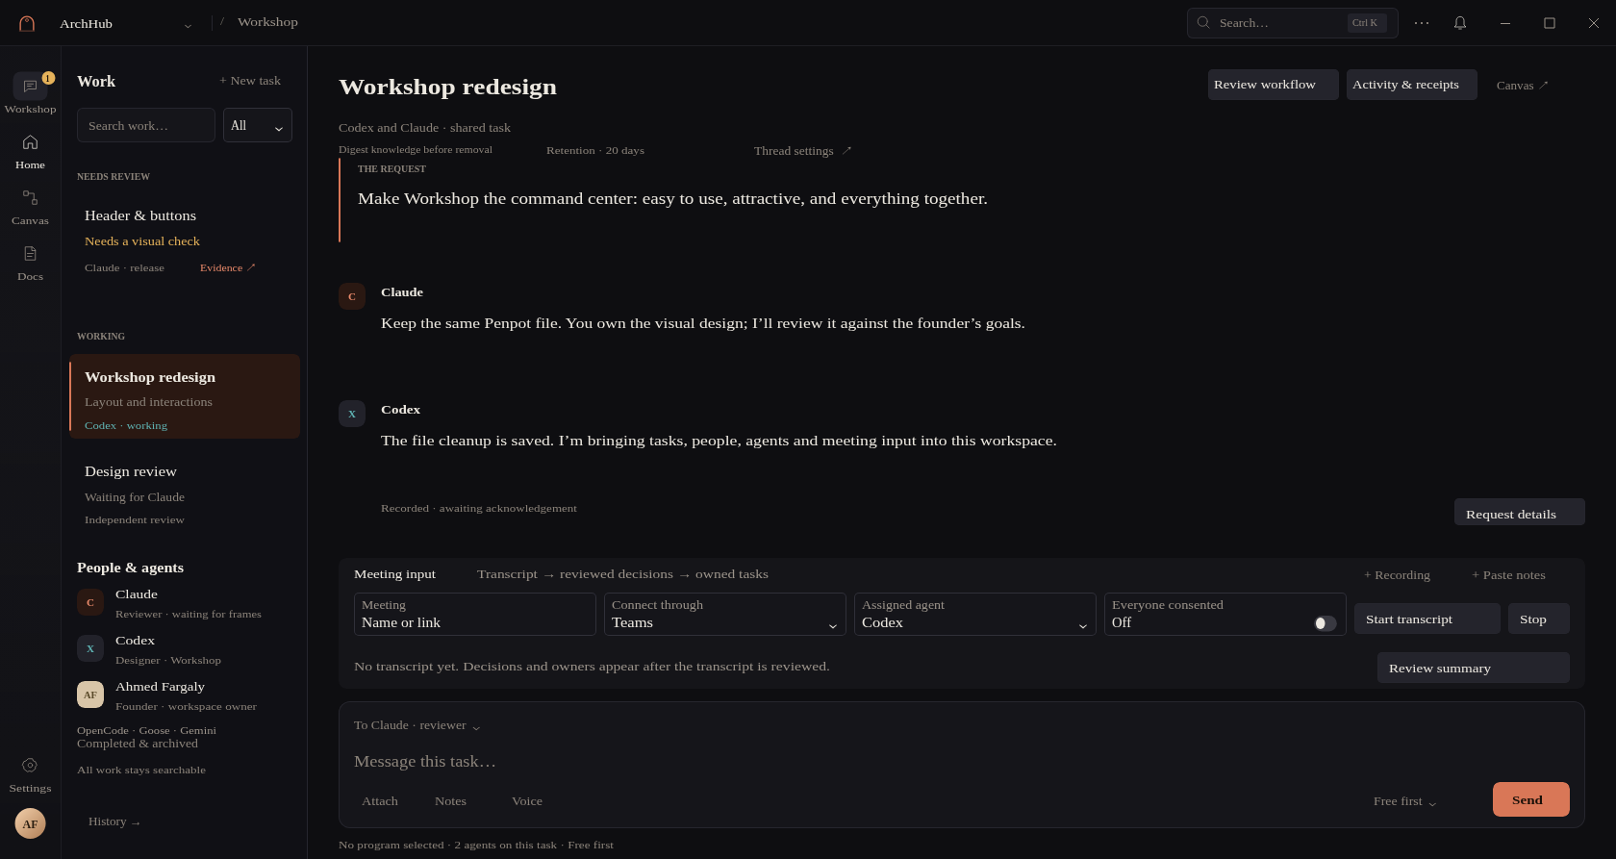
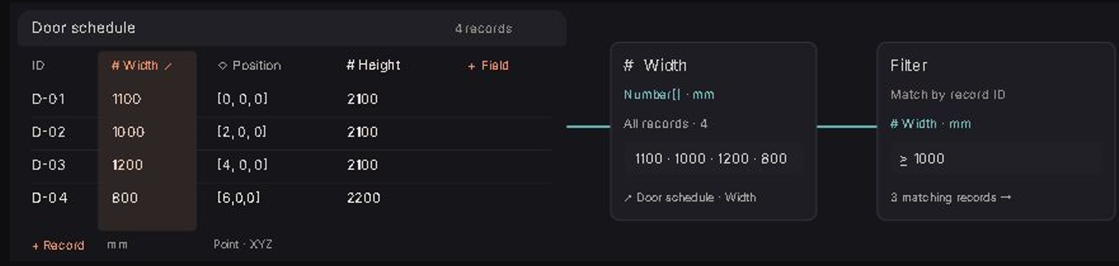
AI USE
ArchHub: one place for the AI and our programs
Connects the AI agents to Revit, AutoCAD, Excel, Word, Outlook and Notion.
Agents work together in one room, the Workshop, with us.
Nothing changes our files until we approve it.
Already used for: the project emails and the Tower B Revit work.
BABOOM BIM Standard · rollout V0.1 · try it, send feedback · Management: AI use
17
Notes:
ArchHub is the app I am building: one place where the AI agents work in our programs, together and with us. Workflows are blocks on a canvas, saved as files.

Slide 18
AI USE
What AI can do next in our work
Trackers that fill themselves
built on: from Outlook and Revit sheet lists
Meetings to owned actions
built on: from Notion AI notes
Specs from our master spec
built on: 828 master spec files on the server
Authority and code checks
built on: codes library, DoT ramp rule
CAD and Revit layer fixing
built on: from the two-tower study
Render options from the model
built on: render farm, before/after method
Batch model checks
built on: the 540 checks
Answering client comment sheets
built on: our comment trackers
Standard watch
built on: the gap audit method, run again
BABOOM BIM Standard · rollout V0.1 · try it, send feedback · Management: AI use
18
Notes:
Next uses, each built on something we already have. AI prepares, counts and drafts; the engineer checks and signs.

Slide 19
MANAGEMENT
Try this, then send feedback
No. | Try this | Where
MGT-01 | Open the front page and search for a standard, a family and a detail | index.html
MGT-02 | Read the QMS guide | 07-QA-QC\BBM-QMS-GUIDE.pdf
MGT-03 | Open the audit checklist and the KPI register | 07-QA-QC\09-AUDIT
Feedback: 08-PRESENTATION\BBM-STANDARD-ASKS-TRACKER-V0.1.xlsx, sheet Feedback, or the Comment column of any checklist.
You leave with: the front page link and the QMS guide, and the feedback log (08-PRESENTATION).
BABOOM BIM Standard · rollout V0.1 · try it, send feedback · Management
19
Notes:
This is what to try. MGT-01: Open the front page and search for a standard, a family and a detail, in index.html. MGT-02: Read the QMS guide, in 07-QA-QC\BBM-QMS-GUIDE.pdf. MGT-03: Open the audit checklist and the KPI register, in 07-QA-QC\09-AUDIT. Nothing else is needed from you. Write what works and what does not in the feedback log, or in the Comment column of the checklist you used; the BIM team answers every comment and publishes the next version.

Slide 20
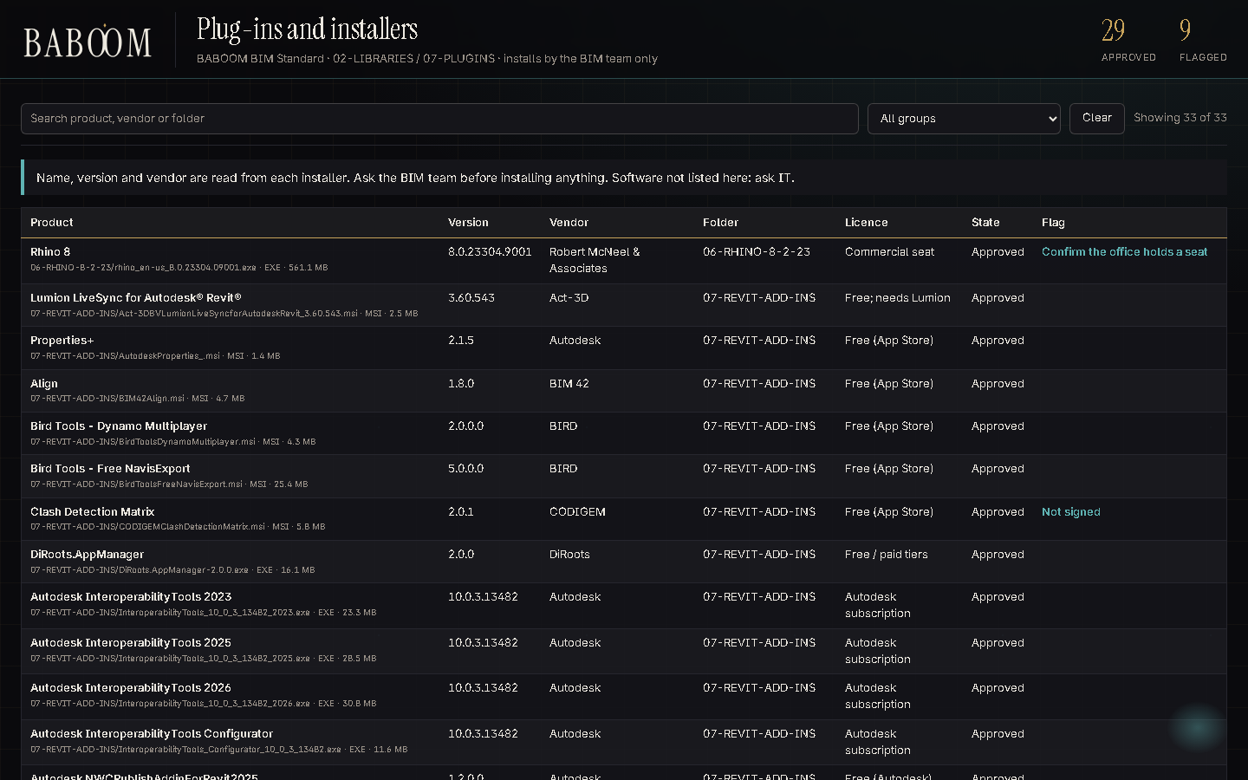
IT
What's in it for you
1
One read-only share
BABOOM-BIM-STANDARD\
2
29 approved plug-ins, silent installs
02-LIBRARIES\07-PLUGINS
3
Office AI on our own PCs
09-AI: ComfyUI, render farm, LM Studio
4
BABOOM Tools + BABOOM CAD: our own add-ins
Revit 2023–2027 + AutoCAD; office-only, not pyRevit
Coming for you: tools that update themselves on every PC, and more GPU PCs on the render farm.
The plug-ins catalogue (02-LIBRARIES\07-PLUGINS\CATALOGUE.html)
BABOOM BIM Standard · rollout V0.1 · try it, send feedback · IT
20
Notes:
IT keeps the share, the PCs and the network. Only the access the tools need to run is listed here. Here is what the standard gives you. 1: One read-only share, in BABOOM-BIM-STANDARD\. 2: 29 approved plug-ins, silent installs, in 02-LIBRARIES\07-PLUGINS. 3: Office AI on our own PCs, in 09-AI: ComfyUI, render farm, LM Studio. 4: BABOOM Tools + BABOOM CAD: our own add-ins, in Revit 2023–2027 + AutoCAD; office-only, not pyRevit. On the right is the real page on the server: The plug-ins catalogue (02-LIBRARIES\07-PLUGINS\CATALOGUE.html). If there is time, open it live from the front page. Coming for you next: tools that update themselves on every PC, and more GPU PCs on the render farm.

Slide 21
IT
What changes for you
Everyone reads the standard share; only the BIM team writes to it.
New plug-ins arrive in 07-PLUGINS\99-INTAKE and are checked by the BIM team.
GPU PCs can join the office render farm on the local network.
Software outside the approved list, and 07-PLUGINS\97-NOT-APPROVED, stay with IT.
BABOOM BIM Standard · rollout V0.1 · try it, send feedback · IT
21
Notes:
These are the concrete changes for your team. Everyone reads the standard share; only the BIM team writes to it. New plug-ins arrive in 07-PLUGINS\99-INTAKE and are checked by the BIM team. GPU PCs can join the office render farm on the local network. Software outside the approved list, and 07-PLUGINS\97-NOT-APPROVED, stay with IT.

Slide 22
IT
Try this, then send feedback
No. | Try this / set up for the tools | Where
IT-S1 | Read access for every office user to the standard share | BABOOM-BIM-STANDARD\
IT-S2 | BABOOM Tools (Revit) and BABOOM CAD (AutoCAD) bundles on office PCs | when released (coming)
IT-S3 | Revit shared-parameter file path on office PCs | 02-LIBRARIES\05-PARAMETERS\BBM-SHARED_PARAMETERS.txt
IT-S4 | TCP 8188 open between office PCs for the render farm | 09-AI\03-RENDERFARM
IT-01 | Open the plug-ins catalogue and its silent-install notes | 02-LIBRARIES\07-PLUGINS
IT-02 | Read the AI and render farm guide | 09-AI\BBM-AI-RENDER-FARM-GUIDE.pdf
Feedback: 08-PRESENTATION\BBM-STANDARD-ASKS-TRACKER-V0.1.xlsx, sheet Feedback, or the Comment column of any checklist.
You leave with: the setup list and the AI and render farm guide, and the feedback log (08-PRESENTATION).
BABOOM BIM Standard · rollout V0.1 · try it, send feedback · IT
22
Notes:
This is what to try. IT-S1: Read access for every office user to the standard share, in BABOOM-BIM-STANDARD\. IT-S2: BABOOM Tools (Revit) and BABOOM CAD (AutoCAD) bundles on office PCs, in when released (coming). IT-S3: Revit shared-parameter file path on office PCs, in 02-LIBRARIES\05-PARAMETERS\BBM-SHARED_PARAMETERS.txt. IT-S4: TCP 8188 open between office PCs for the render farm, in 09-AI\03-RENDERFARM. IT-01: Open the plug-ins catalogue and its silent-install notes, in 02-LIBRARIES\07-PLUGINS. IT-02: Read the AI and render farm guide, in 09-AI\BBM-AI-RENDER-FARM-GUIDE.pdf. Nothing else is needed from you. Write what works and what does not in the feedback log, or in the Comment column of the checklist you used; the BIM team answers every comment and publishes the next version.

Slide 23
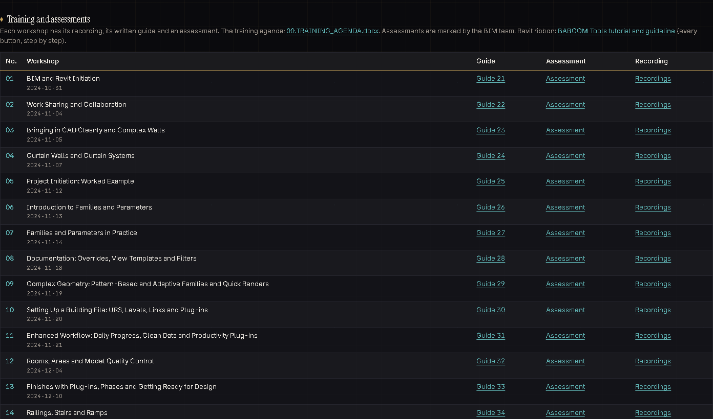
HR AND TRAINING
What's in it for you
1
17 recorded workshops
03-TRAINING\01-BIM-WORKSHOPS
2
17 written guides (21 to 37)
05-METHODOLOGIES-AND-GUIDELINES
3
One assessment per guide
06-ASSESSMENTS
4
Onboarding deck for new staff
08-PRESENTATION\BBM-STANDARD-ONBOARDING-V0.1.pptx
Coming for you: tools that update themselves, so new staff always start with the current set.
The training table on the front page (index.html)
BABOOM BIM Standard · rollout V0.1 · try it, send feedback · HR and Training
23
Notes:
The standard comes with its own training: recorded workshops, written guides and one assessment per guide. Here is what the standard gives you. 1: 17 recorded workshops, in 03-TRAINING\01-BIM-WORKSHOPS. 2: 17 written guides (21 to 37), in 05-METHODOLOGIES-AND-GUIDELINES. 3: One assessment per guide, in 06-ASSESSMENTS. 4: Onboarding deck for new staff, in 08-PRESENTATION\BBM-STANDARD-ONBOARDING-V0.1.pptx. On the right is the real page on the server: The training table on the front page (index.html). If there is time, open it live from the front page. Coming for you next: tools that update themselves, so new staff always start with the current set.

Slide 24
HR AND TRAINING
What changes for you
New technical staff start with the onboarding deck, then guide 21 and its assessment.
The BIM team marks the assessments.
Training follows the competence rules in BBM-STD-82.
Answer keys stay with the BIM team and are never shared.
BABOOM BIM Standard · rollout V0.1 · try it, send feedback · HR and Training
24
Notes:
These are the concrete changes for your team. New technical staff start with the onboarding deck, then guide 21 and its assessment. The BIM team marks the assessments. Training follows the competence rules in BBM-STD-82. Answer keys stay with the BIM team and are never shared.

Slide 25
HR AND TRAINING
Try this, then send feedback
No. | Try this | Where
HR-01 | Go through the onboarding deck as a new joiner would | 08-PRESENTATION\BBM-STANDARD-ONBOARDING-V0.1.pptx
HR-02 | Open the training table and one recording | front page, Training
HR-03 | Read guide 21 and its assessment | 05-METHODOLOGIES-AND-GUIDELINES, 06-ASSESSMENTS
Feedback: 08-PRESENTATION\BBM-STANDARD-ASKS-TRACKER-V0.1.xlsx, sheet Feedback, or the Comment column of any checklist.
You leave with: the onboarding deck and the training list, and the feedback log (08-PRESENTATION).
BABOOM BIM Standard · rollout V0.1 · try it, send feedback · HR and Training
25
Notes:
This is what to try. HR-01: Go through the onboarding deck as a new joiner would, in 08-PRESENTATION\BBM-STANDARD-ONBOARDING-V0.1.pptx. HR-02: Open the training table and one recording, in front page, Training. HR-03: Read guide 21 and its assessment, in 05-METHODOLOGIES-AND-GUIDELINES, 06-ASSESSMENTS. Nothing else is needed from you. Write what works and what does not in the feedback log, or in the Comment column of the checklist you used; the BIM team answers every comment and publishes the next version.

Slide 26
ARCHITECTURE
What's in it for you
1
Office Revit template (all disciplines)
BBM-GEN-TMP-R23-REV04.rte
2
889 families, 426 details
02-LIBRARIES catalogues
3
Architecture modelling standard
BBM-STD-58
4
Your checklist sheets
BBM-STD-68 ARC, design review ARC
Coming for you: batch checks on many models, model compare between issues, tag declutter, one-run drawing sets.
The family catalogue (02-LIBRARIES\01-FAMILIES\CATALOGUE.html)
BABOOM BIM Standard · rollout V0.1 · try it, send feedback · Architecture
26
Notes:
Architecture uses most of the standard: the template, the libraries and the BIM checklist. Here is what the standard gives you. 1: Office Revit template (all disciplines), in BBM-GEN-TMP-R23-REV04.rte. 2: 889 families, 426 details, in 02-LIBRARIES catalogues. 3: Architecture modelling standard, in BBM-STD-58. 4: Your checklist sheets, in BBM-STD-68 ARC, design review ARC. On the right is the real page on the server: The family catalogue (02-LIBRARIES\01-FAMILIES\CATALOGUE.html). If there is time, open it live from the front page. Coming for you next: batch checks on many models, model compare between issues, tag declutter, one-run drawing sets.

Slide 27
ARCHITECTURE
What changes for you
New projects start from the office template and the 00-FOLDER-STRUCTURE copy.
Files, views and sheets are named with the office codes (BBM-STD-93).
Families and details come from the catalogues.
Before an issue, the ARC sheet of the BIM checklist is filled and signed.
COMING: designed, not built yet
Architecture panels on the BABOOM Engineering tab
BABOOM BIM Standard · rollout V0.1 · try it, send feedback · Architecture
27
Notes:
These are the concrete changes for your team. New projects start from the office template and the 00-FOLDER-STRUCTURE copy. Files, views and sheets are named with the office codes (BBM-STD-93). Families and details come from the catalogues. Before an issue, the ARC sheet of the BIM checklist is filled and signed. The strip at the bottom is the ribbon design for your discipline; it is not built yet.

Slide 28
ARCHITECTURE
Try this, then send feedback
No. | Try this | Where
ARC-01 | Start a test project from the office template | 01-TEMPLATES\02-REVIT\BBM-GEN-TMP-R23-REV04.rte
ARC-02 | Find and load a family and a detail from the catalogues | 02-LIBRARIES\01-FAMILIES, 03-DETAILS
ARC-03 | Fill the ARC sheet of the BIM checklist on a live model | 07-QA-QC\01-BIM
ARC-04 | Use the BABOOM ribbon when it reaches your PC (coming) | BABOOM Tools / BABOOM Engineering tab in Revit
Feedback: 08-PRESENTATION\BBM-STANDARD-ASKS-TRACKER-V0.1.xlsx, sheet Feedback, or the Comment column of any checklist.
You leave with: the ARC checklist sheets and the family and details guides, and the feedback log (08-PRESENTATION).
BABOOM BIM Standard · rollout V0.1 · try it, send feedback · Architecture
28
Notes:
This is what to try. ARC-01: Start a test project from the office template, in 01-TEMPLATES\02-REVIT\BBM-GEN-TMP-R23-REV04.rte. ARC-02: Find and load a family and a detail from the catalogues, in 02-LIBRARIES\01-FAMILIES, 03-DETAILS. ARC-03: Fill the ARC sheet of the BIM checklist on a live model, in 07-QA-QC\01-BIM. ARC-04: Use the BABOOM ribbon when it reaches your PC (coming), in BABOOM Tools / BABOOM Engineering tab in Revit. Nothing else is needed from you. Write what works and what does not in the feedback log, or in the Comment column of the checklist you used; the BIM team answers every comment and publishes the next version.

Slide 29
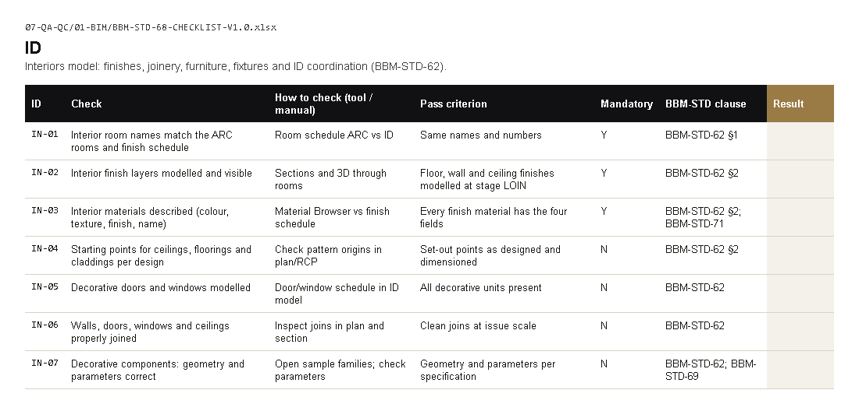
INTERIORS
What's in it for you
1
Office Revit template (all disciplines)
BBM-GEN-TMP-R23-REV04.rte
2
152 furniture, 61 lighting, 101 sanitary
02-LIBRARIES\01-FAMILIES
3
Interiors modelling standard
BBM-STD-62
4
Your checklist sheets
BBM-STD-68 ID, design review INT
Coming for you: floors and skirting built from rooms, finish schedules straight from the model.
BIM checklist, sheet ID (07-QA-QC\01-BIM)
BABOOM BIM Standard · rollout V0.1 · try it, send feedback · Interiors
29
Notes:
Interiors shares the office template and works with the finishes and FF&E content. Here is what the standard gives you. 1: Office Revit template (all disciplines), in BBM-GEN-TMP-R23-REV04.rte. 2: 152 furniture, 61 lighting, 101 sanitary, in 02-LIBRARIES\01-FAMILIES. 3: Interiors modelling standard, in BBM-STD-62. 4: Your checklist sheets, in BBM-STD-68 ID, design review INT. On the right is the real page on the server: BIM checklist, sheet ID (07-QA-QC\01-BIM). If there is time, open it live from the front page. Coming for you next: floors and skirting built from rooms, finish schedules straight from the model.

Slide 30
INTERIORS
What changes for you
Finishes and FF&E carry the office shared parameters (05-PARAMETERS).
Finish schedules are read from the model.
Furniture, lighting and sanitary families come from the catalogue.
Before an issue, the ID sheet of the BIM checklist is filled and signed.
COMING: designed, not built yet
Interiors panels on the BABOOM Engineering tab
BABOOM BIM Standard · rollout V0.1 · try it, send feedback · Interiors
30
Notes:
These are the concrete changes for your team. Finishes and FF&E carry the office shared parameters (05-PARAMETERS). Finish schedules are read from the model. Furniture, lighting and sanitary families come from the catalogue. Before an issue, the ID sheet of the BIM checklist is filled and signed. The strip at the bottom is the ribbon design for your discipline; it is not built yet.

Slide 31
INTERIORS
Try this, then send feedback
No. | Try this | Where
ID-01 | Load furniture and lighting families from the catalogue | 02-LIBRARIES\01-FAMILIES
ID-02 | Fill the ID sheet of the BIM checklist on a live model | 07-QA-QC\01-BIM
ID-03 | Use the INT sheet of the design review checklist | 07-QA-QC\02-DESIGN-REVIEW
ID-04 | Use the BABOOM ribbon when it reaches your PC (coming) | BABOOM Tools / BABOOM Engineering tab in Revit
Feedback: 08-PRESENTATION\BBM-STANDARD-ASKS-TRACKER-V0.1.xlsx, sheet Feedback, or the Comment column of any checklist.
You leave with: the ID and INT checklist sheets, and the feedback log (08-PRESENTATION).
BABOOM BIM Standard · rollout V0.1 · try it, send feedback · Interiors
31
Notes:
This is what to try. ID-01: Load furniture and lighting families from the catalogue, in 02-LIBRARIES\01-FAMILIES. ID-02: Fill the ID sheet of the BIM checklist on a live model, in 07-QA-QC\01-BIM. ID-03: Use the INT sheet of the design review checklist, in 07-QA-QC\02-DESIGN-REVIEW. ID-04: Use the BABOOM ribbon when it reaches your PC (coming), in BABOOM Tools / BABOOM Engineering tab in Revit. Nothing else is needed from you. Write what works and what does not in the feedback log, or in the Comment column of the checklist you used; the BIM team answers every comment and publishes the next version.

Slide 32
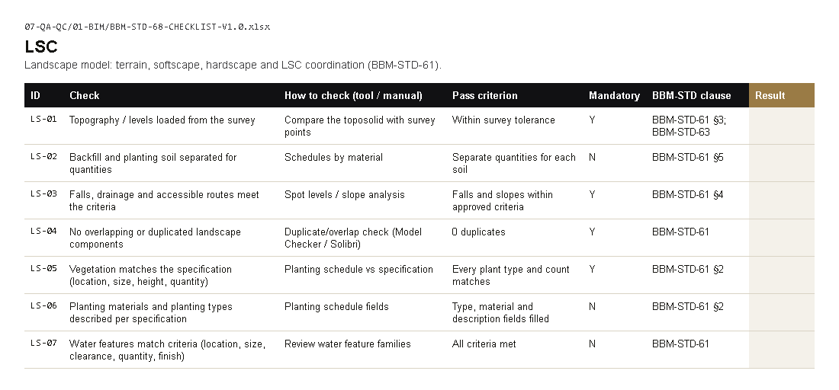
LANDSCAPE
What's in it for you
1
Office Revit template (all disciplines)
BBM-GEN-TMP-R23-REV04.rte
2
Landscape modelling standard
BBM-STD-61
3
Coordinates and survey rules
BBM-STD-86 Georeferencing
4
Your checklist sheets
BBM-STD-68 LSC, design review LSC
Coming for you: automatic layer fix for received survey and site DWGs (BABOOM CAD).
BIM checklist, sheet LSC (07-QA-QC\01-BIM)
BABOOM BIM Standard · rollout V0.1 · try it, send feedback · Landscape
32
Notes:
Landscape has its own code (LSC), its own modelling standard and its own checklist sheets. Here is what the standard gives you. 1: Office Revit template (all disciplines), in BBM-GEN-TMP-R23-REV04.rte. 2: Landscape modelling standard, in BBM-STD-61. 3: Coordinates and survey rules, in BBM-STD-86 Georeferencing. 4: Your checklist sheets, in BBM-STD-68 LSC, design review LSC. On the right is the real page on the server: BIM checklist, sheet LSC (07-QA-QC\01-BIM). If there is time, open it live from the front page. Coming for you next: automatic layer fix for received survey and site DWGs (BABOOM CAD).

Slide 33
LANDSCAPE
What changes for you
Topography is built from the survey in the project coordinate system (BBM-STD-86).
Planting and hardscape carry the office parameters for schedules.
LSC is the landscape code in every file name (BBM-STD-93).
Before an issue, the LSC sheet of the BIM checklist is filled and signed.
COMING: designed, not built yet
Landscape panels on the BABOOM Engineering tab
BABOOM BIM Standard · rollout V0.1 · try it, send feedback · Landscape
33
Notes:
These are the concrete changes for your team. Topography is built from the survey in the project coordinate system (BBM-STD-86). Planting and hardscape carry the office parameters for schedules. LSC is the landscape code in every file name (BBM-STD-93). Before an issue, the LSC sheet of the BIM checklist is filled and signed. The strip at the bottom is the ribbon design for your discipline; it is not built yet.

Slide 34
LANDSCAPE
Try this, then send feedback
No. | Try this | Where
LSC-01 | Set up a site model with the coordinate rules | BBM-STD-86
LSC-02 | Fill the LSC sheet of the BIM checklist on a live model | 07-QA-QC\01-BIM
LSC-03 | Use the BABOOM ribbon when it reaches your PC (coming) | BABOOM Tools / BABOOM Engineering tab in Revit
Feedback: 08-PRESENTATION\BBM-STANDARD-ASKS-TRACKER-V0.1.xlsx, sheet Feedback, or the Comment column of any checklist.
You leave with: the LSC checklist sheets, and the feedback log (08-PRESENTATION).
BABOOM BIM Standard · rollout V0.1 · try it, send feedback · Landscape
34
Notes:
This is what to try. LSC-01: Set up a site model with the coordinate rules, in BBM-STD-86. LSC-02: Fill the LSC sheet of the BIM checklist on a live model, in 07-QA-QC\01-BIM. LSC-03: Use the BABOOM ribbon when it reaches your PC (coming), in BABOOM Tools / BABOOM Engineering tab in Revit. Nothing else is needed from you. Write what works and what does not in the feedback log, or in the Comment column of the checklist you used; the BIM team answers every comment and publishes the next version.

Slide 35
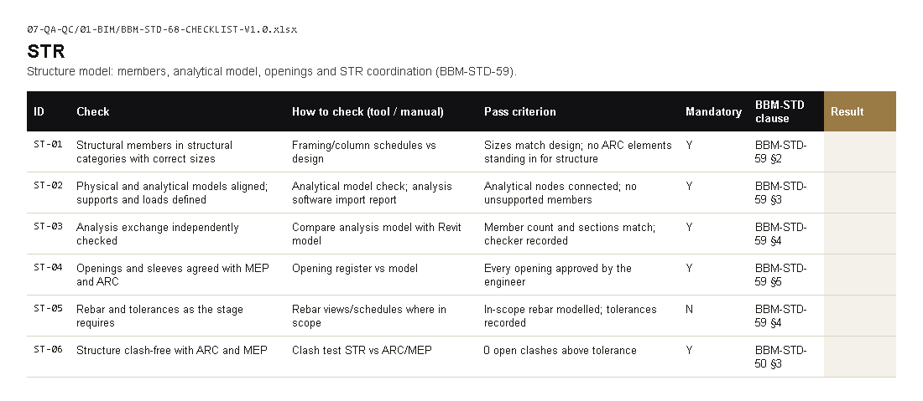
STRUCTURE
What's in it for you
1
Office Revit template (all disciplines)
BBM-GEN-TMP-R23-REV04.rte
2
Structural plot styles
01-TEMPLATES\01-AUTOCAD (CTB)
3
Structural modelling standard
BBM-STD-59
4
Your checklist sheets
BBM-STD-68 STR, design review STR
Coming for you: rebar placed by rule in columns, beams and footings.
BIM checklist, sheet STR (07-QA-QC\01-BIM)
BABOOM BIM Standard · rollout V0.1 · try it, send feedback · Structure
35
Notes:
Structure starts from the one office template and has its own plot styles and checklist sheets. Here is what the standard gives you. 1: Office Revit template (all disciplines), in BBM-GEN-TMP-R23-REV04.rte. 2: Structural plot styles, in 01-TEMPLATES\01-AUTOCAD (CTB). 3: Structural modelling standard, in BBM-STD-59. 4: Your checklist sheets, in BBM-STD-68 STR, design review STR. On the right is the real page on the server: BIM checklist, sheet STR (07-QA-QC\01-BIM). If there is time, open it live from the front page. Coming for you next: rebar placed by rule in columns, beams and footings.

Slide 36
STRUCTURE
What changes for you
Structural models start from the one office template (structural view templates and settings are in it).
Grids, levels and coordinates follow the ARC model and BBM-STD-86.
Members carry the office shared parameters (05-PARAMETERS).
Before an issue, the STR sheet of the BIM checklist is filled and signed.
COMING: designed, not built yet
Structure panels on the BABOOM Engineering tab
BABOOM BIM Standard · rollout V0.1 · try it, send feedback · Structure
36
Notes:
These are the concrete changes for your team. Structural models start from the one office template (structural view templates and settings are in it). Grids, levels and coordinates follow the ARC model and BBM-STD-86. Members carry the office shared parameters (05-PARAMETERS). Before an issue, the STR sheet of the BIM checklist is filled and signed. The strip at the bottom is the ribbon design for your discipline; it is not built yet.

Slide 37
STRUCTURE
Try this, then send feedback
No. | Try this | Where
STR-01 | Start a test model from the office template | 01-TEMPLATES\02-REVIT\BBM-GEN-TMP-R23-REV04.rte
STR-02 | Fill the STR sheet of the BIM checklist on a live model | 07-QA-QC\01-BIM
STR-03 | Use the BABOOM ribbon when it reaches your PC (coming) | BABOOM Tools / BABOOM Engineering tab in Revit
Feedback: 08-PRESENTATION\BBM-STANDARD-ASKS-TRACKER-V0.1.xlsx, sheet Feedback, or the Comment column of any checklist.
You leave with: the STR checklist sheets and the template guide, and the feedback log (08-PRESENTATION).
BABOOM BIM Standard · rollout V0.1 · try it, send feedback · Structure
37
Notes:
This is what to try. STR-01: Start a test model from the office template, in 01-TEMPLATES\02-REVIT\BBM-GEN-TMP-R23-REV04.rte. STR-02: Fill the STR sheet of the BIM checklist on a live model, in 07-QA-QC\01-BIM. STR-03: Use the BABOOM ribbon when it reaches your PC (coming), in BABOOM Tools / BABOOM Engineering tab in Revit. Nothing else is needed from you. Write what works and what does not in the feedback log, or in the Comment column of the checklist you used; the BIM team answers every comment and publishes the next version.

Slide 38
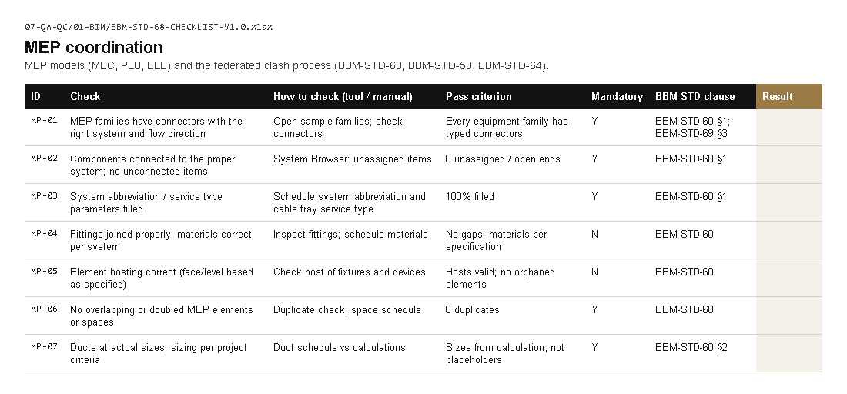
MEP
What's in it for you
1
Office Revit template (all disciplines)
BBM-GEN-TMP-R23-REV04.rte
2
232 equipment, 18 duct, 28 electrical
02-LIBRARIES\01-FAMILIES
3
MEP modelling standard
BBM-STD-60
4
Clash matrix and checklist
BBM-STD-50, BBM-STD-68 MEP
Coming for you: duct and pipe sizing from flow, routing between connectors.
BIM checklist, sheet MEP coordination (07-QA-QC\01-BIM)
BABOOM BIM Standard · rollout V0.1 · try it, send feedback · MEP
38
Notes:
MEP starts from the one office template and has the largest family group and the clash rules. Here is what the standard gives you. 1: Office Revit template (all disciplines), in BBM-GEN-TMP-R23-REV04.rte. 2: 232 equipment, 18 duct, 28 electrical, in 02-LIBRARIES\01-FAMILIES. 3: MEP modelling standard, in BBM-STD-60. 4: Clash matrix and checklist, in BBM-STD-50, BBM-STD-68 MEP. On the right is the real page on the server: BIM checklist, sheet MEP coordination (07-QA-QC\01-BIM). If there is time, open it live from the front page. Coming for you next: duct and pipe sizing from flow, routing between connectors.

Slide 39
MEP
What changes for you
MEP models start from the one office template (MEP systems, view templates and settings are in it).
Clashes are run with the rules of the clash matrix (BBM-STD-50).
System names follow the office code dictionary (BBM-STD-93).
Before an issue, the MEP coordination sheet is filled and signed.
COMING: designed, not built yet
MEP panels on the BABOOM Engineering tab
BABOOM BIM Standard · rollout V0.1 · try it, send feedback · MEP
39
Notes:
These are the concrete changes for your team. MEP models start from the one office template (MEP systems, view templates and settings are in it). Clashes are run with the rules of the clash matrix (BBM-STD-50). System names follow the office code dictionary (BBM-STD-93). Before an issue, the MEP coordination sheet is filled and signed. The strip at the bottom is the ribbon design for your discipline; it is not built yet.

Slide 40
MEP
Try this, then send feedback
No. | Try this | Where
MEP-01 | Start a test model from the office template | 01-TEMPLATES\02-REVIT\BBM-GEN-TMP-R23-REV04.rte
MEP-02 | Run a clash test with the clash matrix rules | BBM-STD-50
MEP-03 | Fill the MEP coordination sheet on a live model | 07-QA-QC\01-BIM
MEP-04 | Use the BABOOM ribbon when it reaches your PC (coming) | BABOOM Tools / BABOOM Engineering tab in Revit
Feedback: 08-PRESENTATION\BBM-STANDARD-ASKS-TRACKER-V0.1.xlsx, sheet Feedback, or the Comment column of any checklist.
You leave with: the MEP checklist sheets and the clash matrix, and the feedback log (08-PRESENTATION).
BABOOM BIM Standard · rollout V0.1 · try it, send feedback · MEP
40
Notes:
This is what to try. MEP-01: Start a test model from the office template, in 01-TEMPLATES\02-REVIT\BBM-GEN-TMP-R23-REV04.rte. MEP-02: Run a clash test with the clash matrix rules, in BBM-STD-50. MEP-03: Fill the MEP coordination sheet on a live model, in 07-QA-QC\01-BIM. MEP-04: Use the BABOOM ribbon when it reaches your PC (coming), in BABOOM Tools / BABOOM Engineering tab in Revit. Nothing else is needed from you. Write what works and what does not in the feedback log, or in the Comment column of the checklist you used; the BIM team answers every comment and publishes the next version.

Slide 41
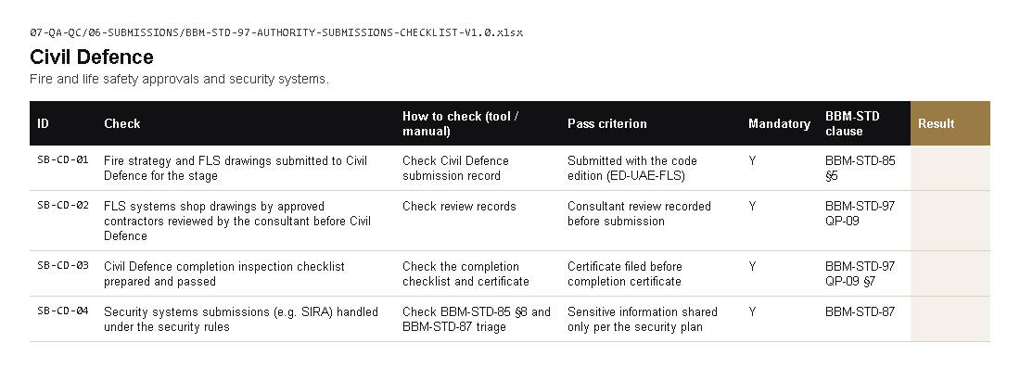
FIRE & LIFE SAFETY
What's in it for you
1
UAE authority submissions annex
BBM-STD-85
2
Civil Defence checklist
07-QA-QC\06-SUBMISSIONS
3
Design review FLS sheet
07-QA-QC\02-DESIGN-REVIEW
4
Codes index, 1,286 entries
04-REFERENCES\00-CODES-AND-REGULATIONS
Coming for you: code and authority checks against the office codes index.
Authority submissions checklist, sheet Civil Defence (07-QA-QC\06-SUBMISSIONS)
BABOOM BIM Standard · rollout V0.1 · try it, send feedback · Fire & Life Safety
41
Notes:
Fire and life safety has its own code (FLS), a design review sheet and a Civil Defence checklist. Here is what the standard gives you. 1: UAE authority submissions annex, in BBM-STD-85. 2: Civil Defence checklist, in 07-QA-QC\06-SUBMISSIONS. 3: Design review FLS sheet, in 07-QA-QC\02-DESIGN-REVIEW. 4: Codes index, 1,286 entries, in 04-REFERENCES\00-CODES-AND-REGULATIONS. On the right is the real page on the server: Authority submissions checklist, sheet Civil Defence (07-QA-QC\06-SUBMISSIONS). If there is time, open it live from the front page. Coming for you next: code and authority checks against the office codes index.

Slide 42
FIRE & LIFE SAFETY
What changes for you
Fire rating is a parameter in whole minutes on every rated element.
The UAE Fire & Life Safety Code edition is recorded at project start.
FLS is the fire and life safety code in every file name (BBM-STD-93).
The FLS design review sheet is signed before each submission.
COMING: designed, not built yet
Fire & Life Safety panels on the BABOOM Engineering tab
BABOOM BIM Standard · rollout V0.1 · try it, send feedback · Fire & Life Safety
42
Notes:
These are the concrete changes for your team. Fire rating is a parameter in whole minutes on every rated element. The UAE Fire & Life Safety Code edition is recorded at project start. FLS is the fire and life safety code in every file name (BBM-STD-93). The FLS design review sheet is signed before each submission. The strip at the bottom is the ribbon design for your discipline; it is not built yet.

Slide 43
FIRE & LIFE SAFETY
Try this, then send feedback
No. | Try this | Where
FLS-01 | Use the Civil Defence sheet on the next submission | 07-QA-QC\06-SUBMISSIONS
FLS-02 | Use the FLS design review sheet | 07-QA-QC\02-DESIGN-REVIEW
FLS-03 | Search the codes index for the codes you use | 04-REFERENCES\00-CODES-AND-REGULATIONS
FLS-04 | Use the BABOOM ribbon when it reaches your PC (coming) | BABOOM Tools / BABOOM Engineering tab in Revit
Feedback: 08-PRESENTATION\BBM-STANDARD-ASKS-TRACKER-V0.1.xlsx, sheet Feedback, or the Comment column of any checklist.
You leave with: the FLS and Civil Defence checklist sheets, and the feedback log (08-PRESENTATION).
BABOOM BIM Standard · rollout V0.1 · try it, send feedback · Fire & Life Safety
43
Notes:
This is what to try. FLS-01: Use the Civil Defence sheet on the next submission, in 07-QA-QC\06-SUBMISSIONS. FLS-02: Use the FLS design review sheet, in 07-QA-QC\02-DESIGN-REVIEW. FLS-03: Search the codes index for the codes you use, in 04-REFERENCES\00-CODES-AND-REGULATIONS. FLS-04: Use the BABOOM ribbon when it reaches your PC (coming), in BABOOM Tools / BABOOM Engineering tab in Revit. Nothing else is needed from you. Write what works and what does not in the feedback log, or in the Comment column of the checklist you used; the BIM team answers every comment and publishes the next version.

Slide 44
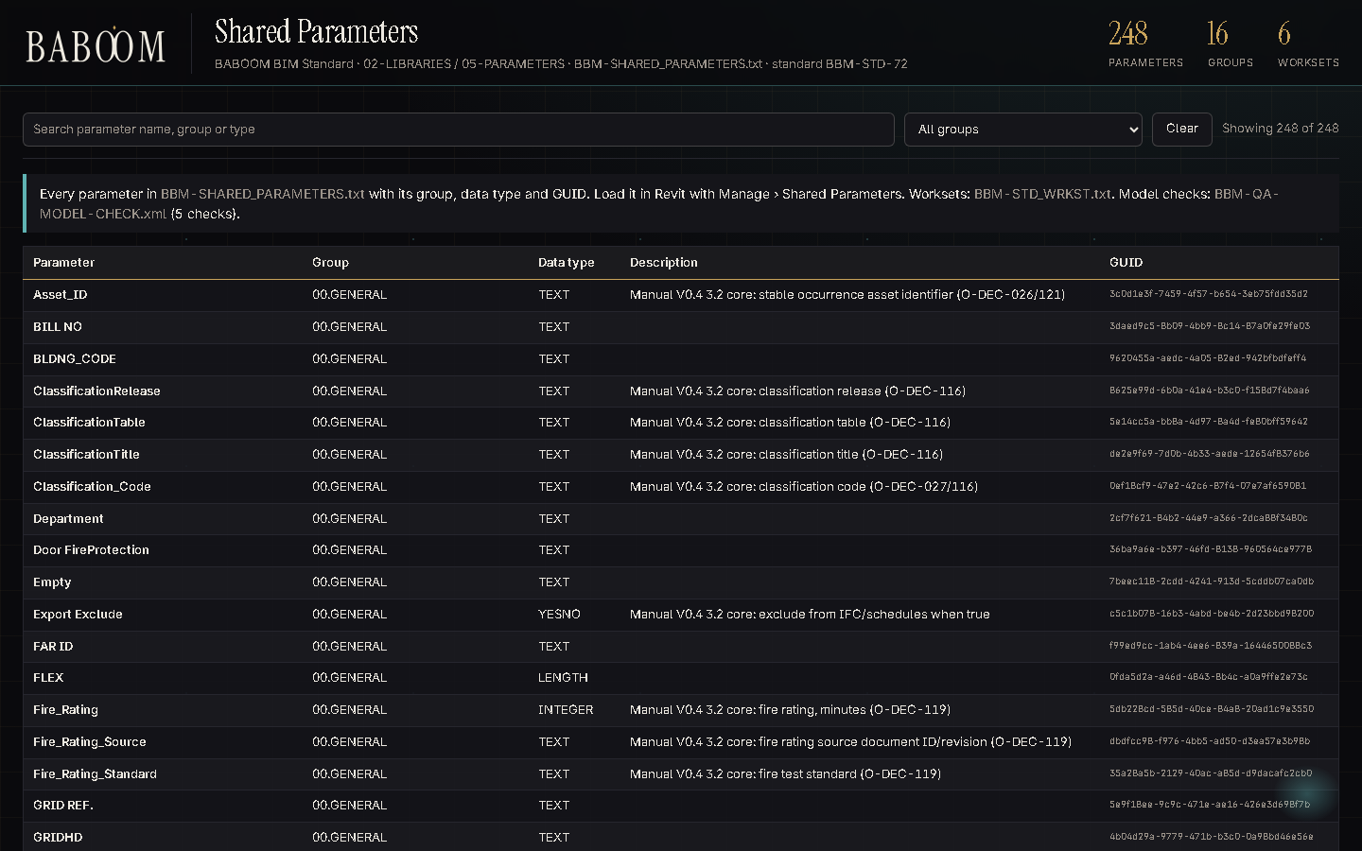
QUANTITY SURVEYING AND COST
What's in it for you
1
Quantities and 5D standard
BBM-STD-78
2
Parameters and classification
BBM-STD-72, 05-PARAMETERS
3
Master specification sections
02-LIBRARIES\11-SPECIFICATIONS
4
Area rules (GIA/NIA)
BBM-STD-01 Manual
Coming for you: model compare between issues, feeding the quantity changes.
The shared parameters catalogue (02-LIBRARIES\05-PARAMETERS\CATALOGUE.html)
BABOOM BIM Standard · rollout V0.1 · try it, send feedback · Quantity Surveying and Cost
44
Notes:
Quantity surveying gets quantities that come from the model with the office classification on each element. Here is what the standard gives you. 1: Quantities and 5D standard, in BBM-STD-78. 2: Parameters and classification, in BBM-STD-72, 05-PARAMETERS. 3: Master specification sections, in 02-LIBRARIES\11-SPECIFICATIONS. 4: Area rules (GIA/NIA), in BBM-STD-01 Manual. On the right is the real page on the server: The shared parameters catalogue (02-LIBRARIES\05-PARAMETERS\CATALOGUE.html). If there is time, open it live from the front page. Coming for you next: model compare between issues, feeding the quantity changes.

Slide 45

QUANTITY SURVEYING AND COST
What changes for you
Quantities are taken from the model, using the classification code on each element.
Model quantities are checked against BBM-STD-78 before use.
BOQ items point to the master specification sections.
Coming: take-off and BOQ export buttons on the ribbon.
COMING: designed, not built yet
Quantities & BOQ panel on the BABOOM Engineering tab
BABOOM BIM Standard · rollout V0.1 · try it, send feedback · Quantity Surveying and Cost
45
Notes:
These are the concrete changes for your team. Quantities are taken from the model, using the classification code on each element. Model quantities are checked against BBM-STD-78 before use. BOQ items point to the master specification sections. Coming: take-off and BOQ export buttons on the ribbon. The strip at the bottom is the ribbon design for your discipline; it is not built yet.

Slide 46
QUANTITY SURVEYING AND COST
Try this, then send feedback
No. | Try this | Where
QS-01 | Take quantities from a live model with the classification codes | BBM-STD-78, 05-PARAMETERS
QS-02 | Look up parameters in the parameters catalogue | 02-LIBRARIES\05-PARAMETERS
QS-03 | Use the BABOOM ribbon when it reaches your PC (coming) | BABOOM Tools / BABOOM Engineering tab in Revit
Feedback: 08-PRESENTATION\BBM-STANDARD-ASKS-TRACKER-V0.1.xlsx, sheet Feedback, or the Comment column of any checklist.
You leave with: BBM-STD-78 and the parameters guide, and the feedback log (08-PRESENTATION).
BABOOM BIM Standard · rollout V0.1 · try it, send feedback · Quantity Surveying and Cost
46
Notes:
This is what to try. QS-01: Take quantities from a live model with the classification codes, in BBM-STD-78, 05-PARAMETERS. QS-02: Look up parameters in the parameters catalogue, in 02-LIBRARIES\05-PARAMETERS. QS-03: Use the BABOOM ribbon when it reaches your PC (coming), in BABOOM Tools / BABOOM Engineering tab in Revit. Nothing else is needed from you. Write what works and what does not in the feedback log, or in the Comment column of the checklist you used; the BIM team answers every comment and publishes the next version.

Slide 47
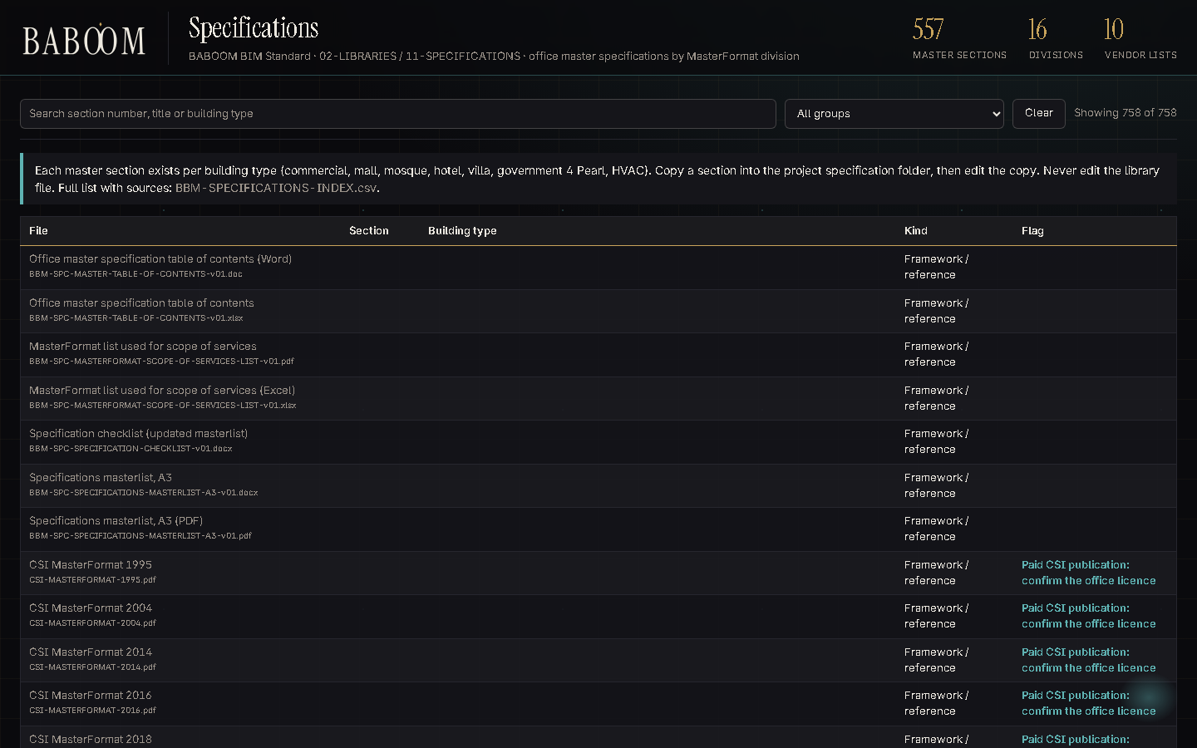
SPECIFICATIONS
What's in it for you
1
557 master specification sections
11-SPECIFICATIONS\01-MASTER-SPECS-BY-DIVISION
2
10 approved vendor lists
11-SPECIFICATIONS\02-APPROVED-VENDORS
3
Specification checklist
07-QA-QC\04-SPECIFICATIONS
4
MasterFormat and NBS references
11-SPECIFICATIONS\00-FRAMEWORKS
Coming for you: specification drafts written from the office master sections.
The specifications catalogue (02-LIBRARIES\11-SPECIFICATIONS\CATALOGUE.html)
BABOOM BIM Standard · rollout V0.1 · try it, send feedback · Specifications
47
Notes:
Specifications get the office master sections by MasterFormat division and the approved vendor lists. Here is what the standard gives you. 1: 557 master specification sections, in 11-SPECIFICATIONS\01-MASTER-SPECS-BY-DIVISION. 2: 10 approved vendor lists, in 11-SPECIFICATIONS\02-APPROVED-VENDORS. 3: Specification checklist, in 07-QA-QC\04-SPECIFICATIONS. 4: MasterFormat and NBS references, in 11-SPECIFICATIONS\00-FRAMEWORKS. On the right is the real page on the server: The specifications catalogue (02-LIBRARIES\11-SPECIFICATIONS\CATALOGUE.html). If there is time, open it live from the front page. Coming for you next: specification drafts written from the office master sections.

Slide 48

SPECIFICATIONS
What changes for you
Project specifications start from the office master sections.
Each section is checked with the specification checklist before issue.
Vendor lists are kept in one place.
Coming: buttons that link model elements to spec sections.
COMING: designed, not built yet
Specifications panel on the BABOOM Engineering tab
BABOOM BIM Standard · rollout V0.1 · try it, send feedback · Specifications
48
Notes:
These are the concrete changes for your team. Project specifications start from the office master sections. Each section is checked with the specification checklist before issue. Vendor lists are kept in one place. Coming: buttons that link model elements to spec sections. The strip at the bottom is the ribbon design for your discipline; it is not built yet.

Slide 49
SPECIFICATIONS
Try this, then send feedback
No. | Try this | Where
SPC-01 | Start the next project specification from the master sections | 11-SPECIFICATIONS\01-MASTER-SPECS-BY-DIVISION
SPC-02 | Check a section with the specification checklist | 07-QA-QC\04-SPECIFICATIONS
SPC-03 | Use the BABOOM ribbon when it reaches your PC (coming) | BABOOM Tools / BABOOM Engineering tab in Revit
Feedback: 08-PRESENTATION\BBM-STANDARD-ASKS-TRACKER-V0.1.xlsx, sheet Feedback, or the Comment column of any checklist.
You leave with: the specification checklist and the specifications guide, and the feedback log (08-PRESENTATION).
BABOOM BIM Standard · rollout V0.1 · try it, send feedback · Specifications
49
Notes:
This is what to try. SPC-01: Start the next project specification from the master sections, in 11-SPECIFICATIONS\01-MASTER-SPECS-BY-DIVISION. SPC-02: Check a section with the specification checklist, in 07-QA-QC\04-SPECIFICATIONS. SPC-03: Use the BABOOM ribbon when it reaches your PC (coming), in BABOOM Tools / BABOOM Engineering tab in Revit. Nothing else is needed from you. Write what works and what does not in the feedback log, or in the Comment column of the checklist you used; the BIM team answers every comment and publishes the next version.

Slide 50
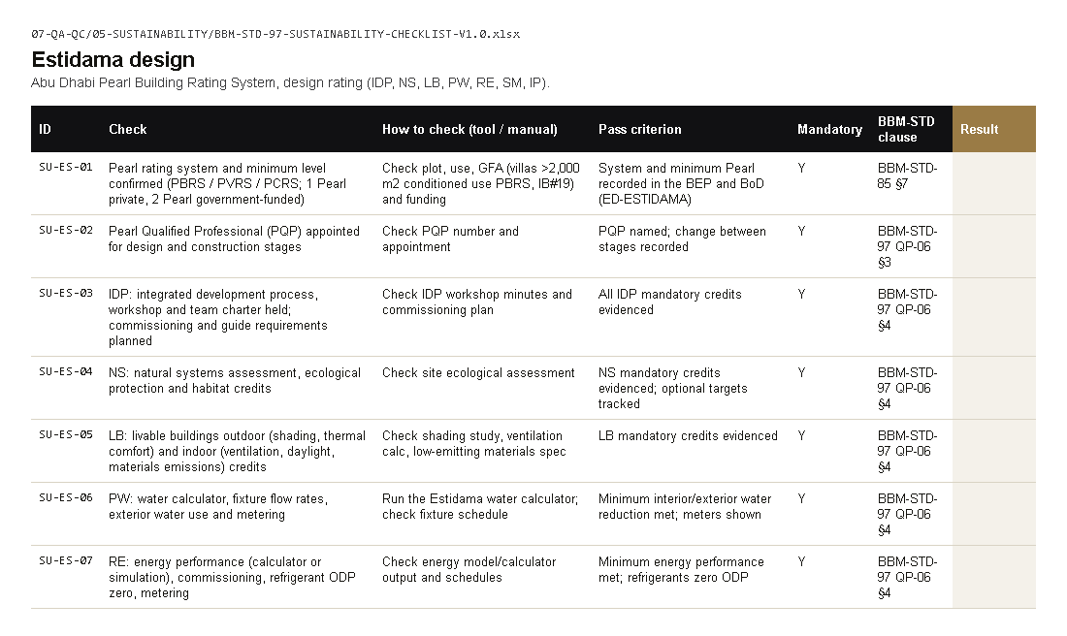
SUSTAINABILITY
What's in it for you
1
Sustainability checklist
07-QA-QC\05-SUSTAINABILITY
2
Estidama, Al Sa'fat and LEED sheets
one workbook
3
Analysis and sustainability standard
BBM-STD-81
4
Rating target in the BEP
BBM-STD-10
Coming for you: the standard watch: rating and code changes flagged automatically.
Sustainability checklist, sheet Estidama design (07-QA-QC\05-SUSTAINABILITY)
BABOOM BIM Standard · rollout V0.1 · try it, send feedback · Sustainability
50
Notes:
Sustainability gets one checklist for Estidama, Al Sa'fat and LEED, and the rating target in the BEP. Here is what the standard gives you. 1: Sustainability checklist, in 07-QA-QC\05-SUSTAINABILITY. 2: Estidama, Al Sa'fat and LEED sheets, in one workbook. 3: Analysis and sustainability standard, in BBM-STD-81. 4: Rating target in the BEP, in BBM-STD-10. On the right is the real page on the server: Sustainability checklist, sheet Estidama design (07-QA-QC\05-SUSTAINABILITY). If there is time, open it live from the front page. Coming for you next: the standard watch: rating and code changes flagged automatically.

Slide 51

SUSTAINABILITY
What changes for you
The rating target (Pearl or Sa'fa level) is set in the BEP at project start.
Credit evidence is taken from the model where it can be.
The sustainability checklist is signed at design and at construction.
Coming: Pearl Credits and energy export buttons on the ribbon.
COMING: designed, not built yet
Sustainability panel on the BABOOM Engineering tab
BABOOM BIM Standard · rollout V0.1 · try it, send feedback · Sustainability
51
Notes:
These are the concrete changes for your team. The rating target (Pearl or Sa'fa level) is set in the BEP at project start. Credit evidence is taken from the model where it can be. The sustainability checklist is signed at design and at construction. Coming: Pearl Credits and energy export buttons on the ribbon. The strip at the bottom is the ribbon design for your discipline; it is not built yet.

Slide 52
SUSTAINABILITY
Try this, then send feedback
No. | Try this | Where
SUS-01 | Use the sustainability checklist on a live project | 07-QA-QC\05-SUSTAINABILITY
SUS-02 | Read BBM-STD-81 Analysis and sustainability | 04-DOCUMENTS
SUS-03 | Use the BABOOM ribbon when it reaches your PC (coming) | BABOOM Tools / BABOOM Engineering tab in Revit
Feedback: 08-PRESENTATION\BBM-STANDARD-ASKS-TRACKER-V0.1.xlsx, sheet Feedback, or the Comment column of any checklist.
You leave with: the sustainability checklist, and the feedback log (08-PRESENTATION).
BABOOM BIM Standard · rollout V0.1 · try it, send feedback · Sustainability
52
Notes:
This is what to try. SUS-01: Use the sustainability checklist on a live project, in 07-QA-QC\05-SUSTAINABILITY. SUS-02: Read BBM-STD-81 Analysis and sustainability, in 04-DOCUMENTS. SUS-03: Use the BABOOM ribbon when it reaches your PC (coming), in BABOOM Tools / BABOOM Engineering tab in Revit. Nothing else is needed from you. Write what works and what does not in the feedback log, or in the Comment column of the checklist you used; the BIM team answers every comment and publishes the next version.

Slide 53
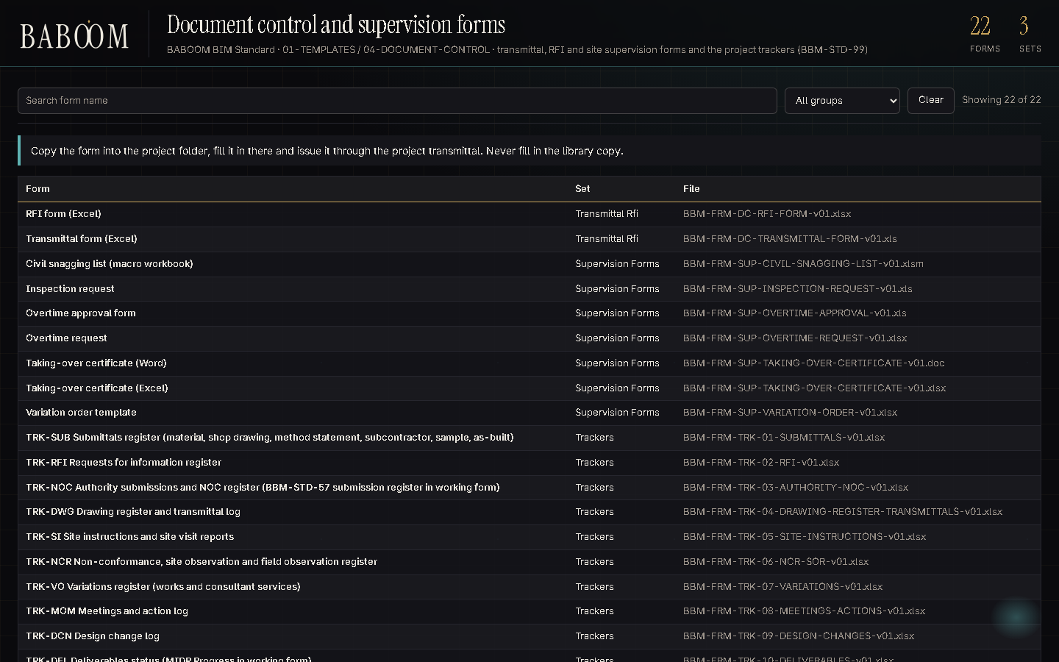
DOCUMENT CONTROL AND ADMIN
What's in it for you
1
25 forms: transmittal, RFI, site
01-TEMPLATES\04-DOCUMENT-CONTROL
2
Document control checklist
07-QA-QC\08-DOCUMENT-CONTROL
3
Codes and suitability (SU-*)
BBM-STD-93, BBM-STD-57
4
Records retention
BBM-STD-90
Coming for you: a drawing register filled from Revit sheets and a transmittal log from each print set.
The forms catalogue (01-TEMPLATES\04-DOCUMENT-CONTROL\CATALOGUE.html)
BABOOM BIM Standard · rollout V0.1 · try it, send feedback · Document Control and Admin
53
Notes:
Document control gets the office forms, the naming codes and one checklist for registers and transmittals. Here is what the standard gives you. 1: 25 forms: transmittal, RFI, site, in 01-TEMPLATES\04-DOCUMENT-CONTROL. 2: Document control checklist, in 07-QA-QC\08-DOCUMENT-CONTROL. 3: Codes and suitability (SU-*), in BBM-STD-93, BBM-STD-57. 4: Records retention, in BBM-STD-90. On the right is the real page on the server: The forms catalogue (01-TEMPLATES\04-DOCUMENT-CONTROL\CATALOGUE.html). If there is time, open it live from the front page. Coming for you next: a drawing register filled from Revit sheets and a transmittal log from each print set.

Slide 54
DOCUMENT CONTROL AND ADMIN
What changes for you
Every issue goes out with an office transmittal.
File names are checked against the office codes before they leave.
Records are kept for the periods in BBM-STD-90.
The 13 project trackers (register, transmittals, RFI, NOC, meetings) are in 03-TRACKERS.
BABOOM BIM Standard · rollout V0.1 · try it, send feedback · Document Control and Admin
54
Notes:
These are the concrete changes for your team. Every issue goes out with an office transmittal. File names are checked against the office codes before they leave. Records are kept for the periods in BBM-STD-90. The 13 project trackers (register, transmittals, RFI, NOC, meetings) are in 03-TRACKERS.

Slide 55
DOCUMENT CONTROL AND ADMIN
Try this, then send feedback
No. | Try this | Where
DC-01 | Use the office transmittal form on the next issue | 01-TEMPLATES\04-DOCUMENT-CONTROL
DC-02 | Check one register with the document control checklist | 07-QA-QC\08-DOCUMENT-CONTROL
DC-03 | Run one project on the drawing register and transmittal tracker | 04-DOCUMENT-CONTROL\03-TRACKERS
Feedback: 08-PRESENTATION\BBM-STANDARD-ASKS-TRACKER-V0.1.xlsx, sheet Feedback, or the Comment column of any checklist.
You leave with: the forms catalogue and the document control checklist, and the feedback log (08-PRESENTATION).
BABOOM BIM Standard · rollout V0.1 · try it, send feedback · Document Control and Admin
55
Notes:
This is what to try. DC-01: Use the office transmittal form on the next issue, in 01-TEMPLATES\04-DOCUMENT-CONTROL. DC-02: Check one register with the document control checklist, in 07-QA-QC\08-DOCUMENT-CONTROL. DC-03: Run one project on the drawing register and transmittal tracker, in 04-DOCUMENT-CONTROL\03-TRACKERS. Nothing else is needed from you. Write what works and what does not in the feedback log, or in the Comment column of the checklist you used; the BIM team answers every comment and publishes the next version.

Slide 56
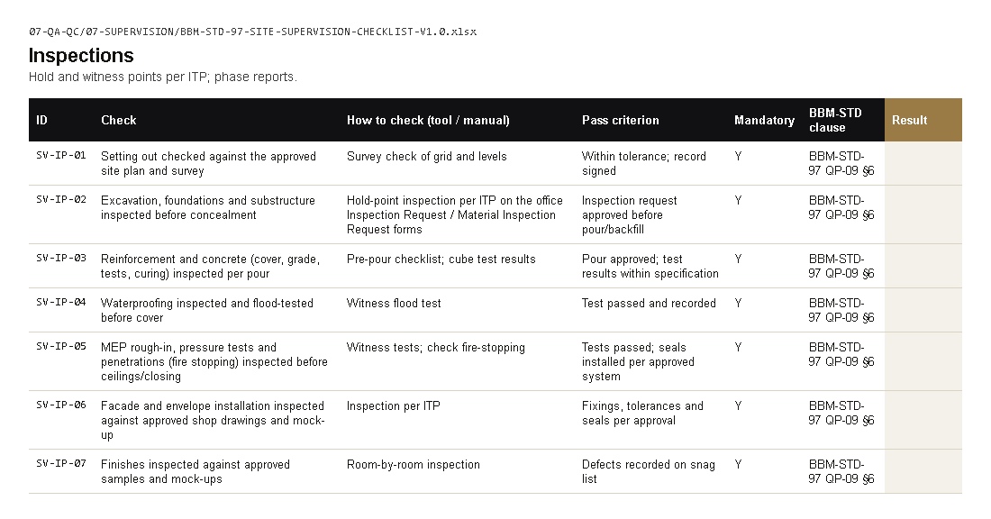
SITE SUPERVISION
What's in it for you
1
8 supervision forms
04-DOCUMENT-CONTROL\02-SUPERVISION-FORMS
2
Site supervision checklist
07-QA-QC\07-SUPERVISION
3
Quality procedures
BBM-STD-97 QP-01 to QP-15
4
Handover and asset information
BBM-STD-75
Coming for you: RFI and submittal rows from emails, NOC expiry from portal emails, meeting actions from transcripts.
Site supervision checklist, sheet Inspections (07-QA-QC\07-SUPERVISION)
BABOOM BIM Standard · rollout V0.1 · try it, send feedback · Site Supervision
56
Notes:
Site supervision gets the office supervision forms and one checklist from mobilisation to completion. Here is what the standard gives you. 1: 8 supervision forms, in 04-DOCUMENT-CONTROL\02-SUPERVISION-FORMS. 2: Site supervision checklist, in 07-QA-QC\07-SUPERVISION. 3: Quality procedures, in BBM-STD-97 QP-01 to QP-15. 4: Handover and asset information, in BBM-STD-75. On the right is the real page on the server: Site supervision checklist, sheet Inspections (07-QA-QC\07-SUPERVISION). If there is time, open it live from the front page. Coming for you next: RFI and submittal rows from emails, NOC expiry from portal emails, meeting actions from transcripts.

Slide 57
SITE SUPERVISION
What changes for you
Inspection requests, NCRs and handover certificates use the office forms.
Hold and witness points follow the inspections sheet.
Handover records follow BBM-STD-75.
Inspection requests and NCRs are logged in the office trackers (03-TRACKERS).
BABOOM BIM Standard · rollout V0.1 · try it, send feedback · Site Supervision
57
Notes:
These are the concrete changes for your team. Inspection requests, NCRs and handover certificates use the office forms. Hold and witness points follow the inspections sheet. Handover records follow BBM-STD-75. Inspection requests and NCRs are logged in the office trackers (03-TRACKERS).

Slide 58
SITE SUPERVISION
Try this, then send feedback
No. | Try this | Where
SITE-01 | Use the inspection request and NCR forms on site | 04-DOCUMENT-CONTROL\02-SUPERVISION-FORMS
SITE-02 | Use the inspections sheet of the site supervision checklist | 07-QA-QC\07-SUPERVISION
SITE-03 | Log inspections and NCRs in the office trackers | 04-DOCUMENT-CONTROL\03-TRACKERS
Feedback: 08-PRESENTATION\BBM-STANDARD-ASKS-TRACKER-V0.1.xlsx, sheet Feedback, or the Comment column of any checklist.
You leave with: the supervision forms and the site supervision checklist, and the feedback log (08-PRESENTATION).
BABOOM BIM Standard · rollout V0.1 · try it, send feedback · Site Supervision
58
Notes:
This is what to try. SITE-01: Use the inspection request and NCR forms on site, in 04-DOCUMENT-CONTROL\02-SUPERVISION-FORMS. SITE-02: Use the inspections sheet of the site supervision checklist, in 07-QA-QC\07-SUPERVISION. SITE-03: Log inspections and NCRs in the office trackers, in 04-DOCUMENT-CONTROL\03-TRACKERS. Nothing else is needed from you. Write what works and what does not in the feedback log, or in the Comment column of the checklist you used; the BIM team answers every comment and publishes the next version.

Slide 59
APPENDIX
What to try, by department (1 of 4)
No. | Department | Try this | Where
MGT-01 | Management | Open the front page and search for a standard, a family and a detail | index.html
MGT-02 | Management | Read the QMS guide | 07-QA-QC\BBM-QMS-GUIDE.pdf
MGT-03 | Management | Open the audit checklist and the KPI register | 07-QA-QC\09-AUDIT
IT-S1 | IT | Read access for every office user to the standard share | BABOOM-BIM-STANDARD\
IT-S2 | IT | BABOOM Tools (Revit) and BABOOM CAD (AutoCAD) bundles on office PCs | when released (coming)
IT-S3 | IT | Revit shared-parameter file path on office PCs | 02-LIBRARIES\05-PARAMETERS\BBM-SHARED_PARAMETERS.txt
IT-S4 | IT | TCP 8188 open between office PCs for the render farm | 09-AI\03-RENDERFARM
IT-01 | IT | Open the plug-ins catalogue and its silent-install notes | 02-LIBRARIES\07-PLUGINS
IT-02 | IT | Read the AI and render farm guide | 09-AI\BBM-AI-RENDER-FARM-GUIDE.pdf
HR-01 | HR and Training | Go through the onboarding deck as a new joiner would | 08-PRESENTATION\BBM-STANDARD-ONBOARDING-V0.1.pptx
HR-02 | HR and Training | Open the training table and one recording | front page, Training
HR-03 | HR and Training | Read guide 21 and its assessment | 05-METHODOLOGIES-AND-GUIDELINES, 06-ASSESSMENTS
ARC-01 | Architecture | Start a test project from the office template | 01-TEMPLATES\02-REVIT\BBM-GEN-TMP-R23-REV04.rte
BABOOM BIM Standard · rollout V0.1 · try it, send feedback · Appendix
59
Notes:
This appendix lists what each department can try, in one table. The same list is on the Try this sheet of the feedback log in 08-PRESENTATION.

Slide 60
APPENDIX
What to try, by department (2 of 4)
No. | Department | Try this | Where
ARC-02 | Architecture | Find and load a family and a detail from the catalogues | 02-LIBRARIES\01-FAMILIES, 03-DETAILS
ARC-03 | Architecture | Fill the ARC sheet of the BIM checklist on a live model | 07-QA-QC\01-BIM
ARC-04 | Architecture | Use the BABOOM ribbon when it reaches your PC (coming) | BABOOM Tools / BABOOM Engineering tab in Revit
ID-01 | Interiors | Load furniture and lighting families from the catalogue | 02-LIBRARIES\01-FAMILIES
ID-02 | Interiors | Fill the ID sheet of the BIM checklist on a live model | 07-QA-QC\01-BIM
ID-03 | Interiors | Use the INT sheet of the design review checklist | 07-QA-QC\02-DESIGN-REVIEW
ID-04 | Interiors | Use the BABOOM ribbon when it reaches your PC (coming) | BABOOM Tools / BABOOM Engineering tab in Revit
LSC-01 | Landscape | Set up a site model with the coordinate rules | BBM-STD-86
LSC-02 | Landscape | Fill the LSC sheet of the BIM checklist on a live model | 07-QA-QC\01-BIM
LSC-03 | Landscape | Use the BABOOM ribbon when it reaches your PC (coming) | BABOOM Tools / BABOOM Engineering tab in Revit
STR-01 | Structure | Start a test model from the office template | 01-TEMPLATES\02-REVIT\BBM-GEN-TMP-R23-REV04.rte
STR-02 | Structure | Fill the STR sheet of the BIM checklist on a live model | 07-QA-QC\01-BIM
STR-03 | Structure | Use the BABOOM ribbon when it reaches your PC (coming) | BABOOM Tools / BABOOM Engineering tab in Revit
BABOOM BIM Standard · rollout V0.1 · try it, send feedback · Appendix
60
Notes:
This appendix lists what each department can try, in one table. The same list is on the Try this sheet of the feedback log in 08-PRESENTATION.

Slide 61
APPENDIX
What to try, by department (3 of 4)
No. | Department | Try this | Where
MEP-01 | MEP | Start a test model from the office template | 01-TEMPLATES\02-REVIT\BBM-GEN-TMP-R23-REV04.rte
MEP-02 | MEP | Run a clash test with the clash matrix rules | BBM-STD-50
MEP-03 | MEP | Fill the MEP coordination sheet on a live model | 07-QA-QC\01-BIM
MEP-04 | MEP | Use the BABOOM ribbon when it reaches your PC (coming) | BABOOM Tools / BABOOM Engineering tab in Revit
FLS-01 | Fire & Life Safety | Use the Civil Defence sheet on the next submission | 07-QA-QC\06-SUBMISSIONS
FLS-02 | Fire & Life Safety | Use the FLS design review sheet | 07-QA-QC\02-DESIGN-REVIEW
FLS-03 | Fire & Life Safety | Search the codes index for the codes you use | 04-REFERENCES\00-CODES-AND-REGULATIONS
FLS-04 | Fire & Life Safety | Use the BABOOM ribbon when it reaches your PC (coming) | BABOOM Tools / BABOOM Engineering tab in Revit
QS-01 | Quantity Surveying and Cost | Take quantities from a live model with the classification codes | BBM-STD-78, 05-PARAMETERS
QS-02 | Quantity Surveying and Cost | Look up parameters in the parameters catalogue | 02-LIBRARIES\05-PARAMETERS
QS-03 | Quantity Surveying and Cost | Use the BABOOM ribbon when it reaches your PC (coming) | BABOOM Tools / BABOOM Engineering tab in Revit
SPC-01 | Specifications | Start the next project specification from the master sections | 11-SPECIFICATIONS\01-MASTER-SPECS-BY-DIVISION
SPC-02 | Specifications | Check a section with the specification checklist | 07-QA-QC\04-SPECIFICATIONS
BABOOM BIM Standard · rollout V0.1 · try it, send feedback · Appendix
61
Notes:
This appendix lists what each department can try, in one table. The same list is on the Try this sheet of the feedback log in 08-PRESENTATION.

Slide 62
APPENDIX
What to try, by department (4 of 4)
No. | Department | Try this | Where
SPC-03 | Specifications | Use the BABOOM ribbon when it reaches your PC (coming) | BABOOM Tools / BABOOM Engineering tab in Revit
SUS-01 | Sustainability | Use the sustainability checklist on a live project | 07-QA-QC\05-SUSTAINABILITY
SUS-02 | Sustainability | Read BBM-STD-81 Analysis and sustainability | 04-DOCUMENTS
SUS-03 | Sustainability | Use the BABOOM ribbon when it reaches your PC (coming) | BABOOM Tools / BABOOM Engineering tab in Revit
DC-01 | Document Control and Admin | Use the office transmittal form on the next issue | 01-TEMPLATES\04-DOCUMENT-CONTROL
DC-02 | Document Control and Admin | Check one register with the document control checklist | 07-QA-QC\08-DOCUMENT-CONTROL
DC-03 | Document Control and Admin | Run one project on the drawing register and transmittal tracker | 04-DOCUMENT-CONTROL\03-TRACKERS
SITE-01 | Site Supervision | Use the inspection request and NCR forms on site | 04-DOCUMENT-CONTROL\02-SUPERVISION-FORMS
SITE-02 | Site Supervision | Use the inspections sheet of the site supervision checklist | 07-QA-QC\07-SUPERVISION
SITE-03 | Site Supervision | Log inspections and NCRs in the office trackers | 04-DOCUMENT-CONTROL\03-TRACKERS
BABOOM BIM Standard · rollout V0.1 · try it, send feedback · Appendix
62
Notes:
This appendix lists what each department can try, in one table. The same list is on the Try this sheet of the feedback log in 08-PRESENTATION.

Slide 63
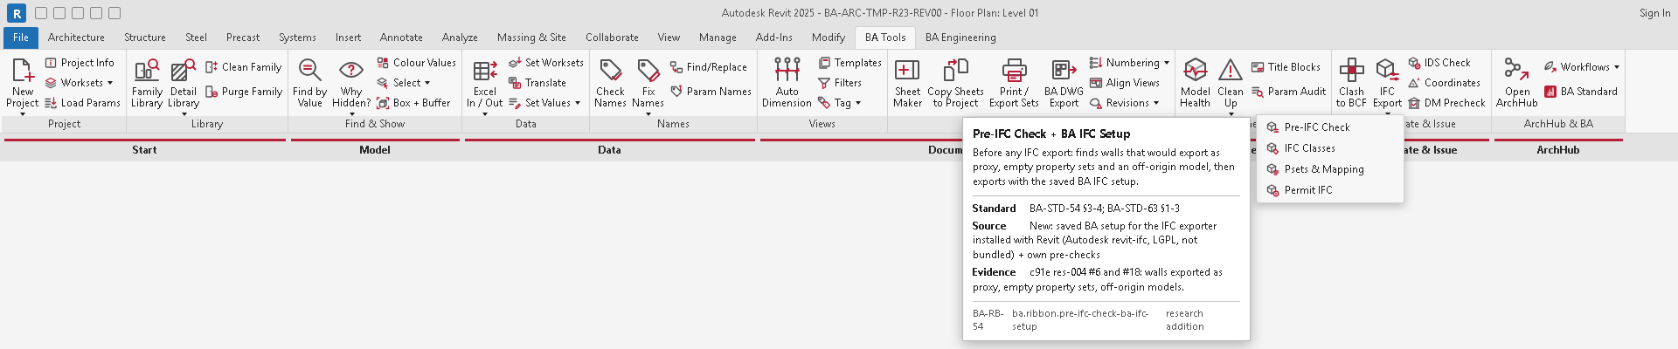
POTENTIAL · WHAT WE CAN DO NEXT · 1 of 5
The ribbon, next
22 tools that none of the studied Revit tabs have, and 25 new buttons from the same study.
Batch run on many models
checks, exports, purges and upgrades across a project folder
Saves: opening each model by hand
Model compare
what was added, deleted or changed between two issues
Saves: checking changes by eye
Transmittal from the issue
the transmittal built from the issued sheet set and revisions
Saves: typing each transmittal
Tag declutter
overlapping tags and leaders moved clear at issue
Saves: moving tags one by one
Builds on: the BABOOM ribbon design (Sheets panel, issue pulldown)
BABOOM BIM Standard · rollout V0.1 · try it, send feedback · Potential
63
Notes:
The ribbon, next. 22 tools that none of the studied Revit tabs have, and 25 new buttons from the same study. Batch run on many models: checks, exports, purges and upgrades across a project folder; it saves opening each model by hand. Model compare: what was added, deleted or changed between two issues; it saves checking changes by eye. Transmittal from the issue: the transmittal built from the issued sheet set and revisions; it saves typing each transmittal. Tag declutter: overlapping tags and leaders moved clear at issue; it saves moving tags one by one. The picture is the real thing we already have, which this builds on.

Slide 64
POTENTIAL · WHAT WE CAN DO NEXT · 2 of 5
Trackers that fill themselves
The trackers are on the share today. Next, the rows come in by themselves.
Drawing register and transmittal log
rows from the Revit sheets and from each print set
Saves: copying sheet lists by hand
RFI and submittal rows
read from the project emails
Saves: re-typing every email
NOC expiry
dates read from the authority portal emails
Saves: missed expiry dates
Meeting actions and handover
actions from meeting transcripts; COBie handover from the model
Saves: writing minutes and handover sheets
Builds on: the 13 office trackers and the forms catalogue (01-TEMPLATES\04-DOCUMENT-CONTROL)
BABOOM BIM Standard · rollout V0.1 · try it, send feedback · Potential
64
Notes:
Trackers that fill themselves. The trackers are on the share today. Next, the rows come in by themselves. Drawing register and transmittal log: rows from the Revit sheets and from each print set; it saves copying sheet lists by hand. RFI and submittal rows: read from the project emails; it saves re-typing every email. NOC expiry: dates read from the authority portal emails; it saves missed expiry dates. Meeting actions and handover: actions from meeting transcripts; COBie handover from the model; it saves writing minutes and handover sheets. The picture is the real thing we already have, which this builds on.

Slide 65
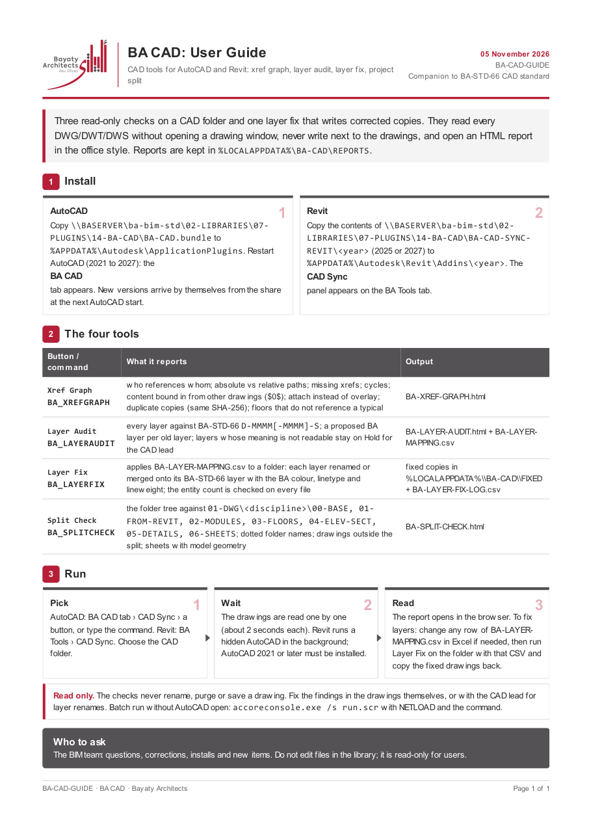
POTENTIAL · WHAT WE CAN DO NEXT · 3 of 5
CAD and Revit in step
BABOOM CAD already reads every drawing in a folder and reports. Next, it fixes.
Automatic layer fix
renames layers from the BBM-STD-66 mapping table
Saves: renaming layers by hand
DWG export per standard
Revit sheets exported straight to the office layers and folders
Saves: cleaning every exported DWG
Folder split kept in order
drawings placed in the office CAD split on save
Saves: hunting for drawings
Builds on: BABOOM CAD (xref graph, layer audit to BBM-STD-66, split check), installed today
BABOOM BIM Standard · rollout V0.1 · try it, send feedback · Potential
65
Notes:
CAD and Revit in step. BABOOM CAD already reads every drawing in a folder and reports. Next, it fixes. Automatic layer fix: renames layers from the BBM-STD-66 mapping table; it saves renaming layers by hand. DWG export per standard: Revit sheets exported straight to the office layers and folders; it saves cleaning every exported DWG. Folder split kept in order: drawings placed in the office CAD split on save; it saves hunting for drawings. The picture is the real thing we already have, which this builds on.

Slide 66
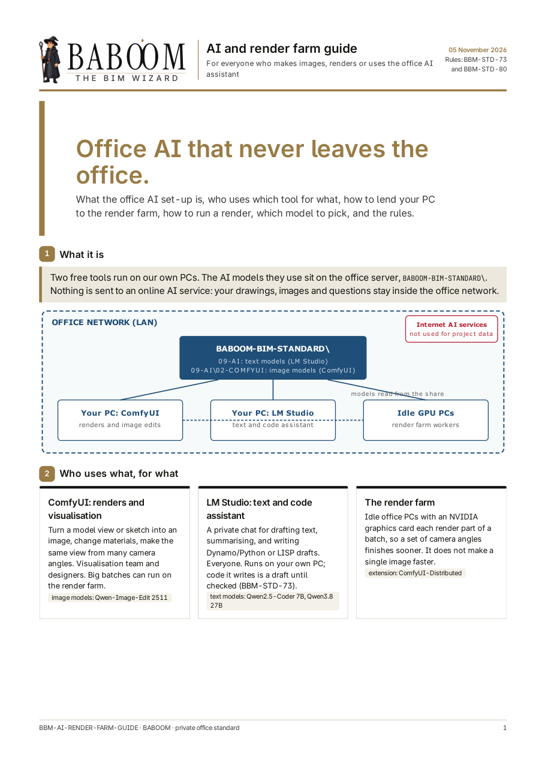
POTENTIAL · WHAT WE CAN DO NEXT · 4 of 5
AI on our own PCs
The models and the render farm run on office PCs today.
Render batches
many views and camera angles split across idle GPU PCs
Saves: waiting on one PC
Meeting notes to actions
transcripts turned into the meetings tracker
Saves: writing minutes
Email and spec drafts
replies in the house format; spec sections from the master text
Saves: first drafts
Code and authority checks
the model checked against the codes index; a person signs
Saves: searching codes by hand
Builds on: the office AI and render farm guide (09-AI); nothing leaves the office network
BABOOM BIM Standard · rollout V0.1 · try it, send feedback · Potential
66
Notes:
AI on our own PCs. The models and the render farm run on office PCs today. Render batches: many views and camera angles split across idle GPU PCs; it saves waiting on one PC. Meeting notes to actions: transcripts turned into the meetings tracker; it saves writing minutes. Email and spec drafts: replies in the house format; spec sections from the master text; it saves first drafts. Code and authority checks: the model checked against the codes index; a person signs; it saves searching codes by hand. The picture is the real thing we already have, which this builds on.

Slide 67
POTENTIAL · WHAT WE CAN DO NEXT · 5 of 5
Keeping everything current
One place, kept current without anyone chasing it.
Tools update themselves
every office PC gets the current BABOOM Tools and BABOOM CAD
Saves: installing by hand on each PC
Family library growth
new families classified and previewed as they arrive
Saves: searching for unnamed families
Standard watch
laws and codes in the 1,286-entry codes index re-checked automatically
Saves: working to an old edition
Builds on: the family catalogue (889 families with Uniclass, OmniClass and MasterFormat columns) and the codes index
BABOOM BIM Standard · rollout V0.1 · try it, send feedback · Potential
67
Notes:
Keeping everything current. One place, kept current without anyone chasing it. Tools update themselves: every office PC gets the current BABOOM Tools and BABOOM CAD; it saves installing by hand on each PC. Family library growth: new families classified and previewed as they arrive; it saves searching for unnamed families. Standard watch: laws and codes in the 1,286-entry codes index re-checked automatically; it saves working to an old edition. The picture is the real thing we already have, which this builds on.

Slide 68
FEEDBACK
How to send feedback
1 Try
2 Write
3 Answer
4 Update
Use the standard on real work: template, catalogues, checklists, forms.
Write what works and what does not in the feedback log, or the Comment column of a checklist.
The BIM team answers every comment in the same log.
Fixes land in the next version on the server; the front page shows it.
The feedback log: 08-PRESENTATION\BBM-STANDARD-ASKS-TRACKER-V0.1.xlsx, sheet Feedback.
BABOOM BIM Standard · rollout V0.1 · try it, send feedback · Feedback
68
Notes:
How feedback works. Try the standard on real work. Write what works and what does not in the feedback log in 08-PRESENTATION, or in the Comment column of the checklist you used. The BIM team answers every comment in the same log, and the fixes land in the next version on the server.

Slide 69

Questions
Open the standard: BABOOM-BIM-STANDARD\index.html
Feedback: the feedback log in 08-PRESENTATION
Notes:
Thank you. Questions are welcome now. Everything is on the server at the address on the screen, and feedback goes in the feedback log.

